Slide 1
Kent Community Transition Council (CTC)
October 24, 2017
Welcome!!
Please sit by someone new to you

Slide 2
Agenda and Outcome
Agenda
Outcomes
Welcome and Why
Transition Dates and Activities
Introduction and Agency Updates
Continuum of School Transition Programs
Predictors of Post-School Success
Continuum of Agency Supports
Case Studies
CTC members will grow in their understanding Kent County Transition System so that we can ensure positive outcomes for all students
CTC members will reflect and analyze effective transition activities so that we develop a system that will have a maximum impact

Slide 3
Transition System
Student Focused Planning
Family Engagement
Program Structures
Interagency Collaboration
Student Development

Slide 4
Kent Community Transition Council Mission
Kent CTC’s mission is have a clear, purposeful, and carefully designed system that promotes cross-agency, cross-program, and cross-disciplinary collaborative efforts leading to tangible transition outcomes for young adults.

Slide 5
Kent ISD
Secondary Transition Technical Assistance
It is Kent ISD’s mission to develop a system of supports throughout secondary education that provides educators the knowledge and resources they need to prepare students for career, training and college.
Getting Ready for Employment
Community Participation
Postsecondary Education/Training
Adult Living

Slide 6
Transition Dates and Activities
Navigating Transition: IEP Compliance and Quality Planning
October 25
Student Transition Conference
November 15
Transition Expo
March 8, 2018

Slide 7
Introduction and Agency Updates
Who you are
Where you work
The students that you support
The services that you provide
Updates to staff and/or the organization
Other?

Slide 8
Continuum of School Transition Programs
Program Descriptions
Program Visual
Table discussions
Do you work with a program listed?
Where would you provide supports/services?
Drafts – any edits/updates

Slide 9
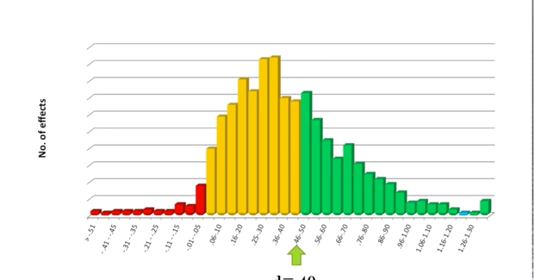
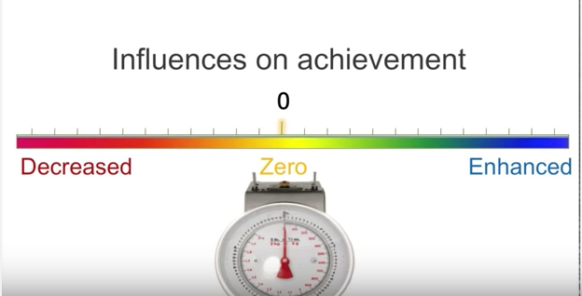
Visible Learning – John Hattie “I want to understand my impact”

Slide 10
Positive Outcomes for Students
Purposeful Planning
Effective Intervention
Effective Implementation

Slide 11
Predictors of Post-School Success
Article
Example of the new research that is occurring in Secondary Transition

Slide 12
Continuum of Agency Supports
Level of Need
Age of Student

Slide 13
Upcoming Schedule
November 21, 2017
January 30, 2018
March 13, 2018
May 8, 2018

