Slide 1

The START Project

Slide 2
What is the START Project?
Established in 2001 to address the increasing number of students with Autism Spectrum Disorder (ASD) in the schools

Slide 3
Where and Who is START?
Housed in GVSU’s Autism Education Center, START is grant-funded by MDE OSE to provide evidence-based training, technical assistance, coaching support, and resources to school-based teams in Michigan that support students with ASD and related-disabilities.
2 GVSU Faculty, 3 Autism Education Specialists, Project Manager, Project Coordinator, Administrative Assistant

Slide 4
START’s Mission
To work with schools, community partners, and families to support students with ASD to become active, engaged members of their schools and local communities and successfully move into adulthood as independent individuals with many choices and opportunities.

Slide 5
START’s Focus
Providing educators with the knowledge and skills to meet the unique and often intense needs of students with ASD use evidence-based practices and best practice tools
Creating and supporting systems-level change implemented by school staff and administrators committed to using evidence-based practices in the areas of educational programming, professional development, parent-professional collaboration and cross-district/county collaboration.

Slide 6
How does START work to achieve this?
Training
Technical Assistance
RCN support
Coaching support
Access to resources through the website

Slide 7
START Training Opportunities
Intensive Training Series:
  Early Childhood – 7 one-day modules; possible additional module in year 2.
      18-19 - CMAC at Shiawassee
  K-12 – Year 1: 7 two-day modules, Admin module; Yr 2 – 4 one-day modules and 1 two-day modules
      18-19 Yr 1 – Oakland Schools
      18-19 Yr 2 – Van Buren ISD & Macomb ISDs
  Building Your Future Secondary Transition (BYF) – 8 one-day modules; Admin module
      18-19 SMAC at Jackson ISD

Slide 8
“Stand-alone” statewide trainings each year on topics such as Peer to Peer Supports, and Self-Management
Upcoming Statewide Training:
Using the PEERS Model as a Basis for Teaching Social Skills to Teens with ASD
February 8, 2019
Kellogg Hotel & Conference Center

Slide 9
START also hosts its an annual conference in Lansing each spring, presenting local and national experts in ASD-related areas.
18th Annual START Conference
Breaking the Social Code
Michelle Garcia Winner & Jed Baker
Monday, April 29th, 2019
Kellogg Hotel & Conference Center
Registration is open

Slide 10
Regional Collaborative Networks
16 RCNs across the state
Supported by START
Most are multi-county/multi-ISD
Increase collaboration and training/learning opportunities within and across regions

Slide 11
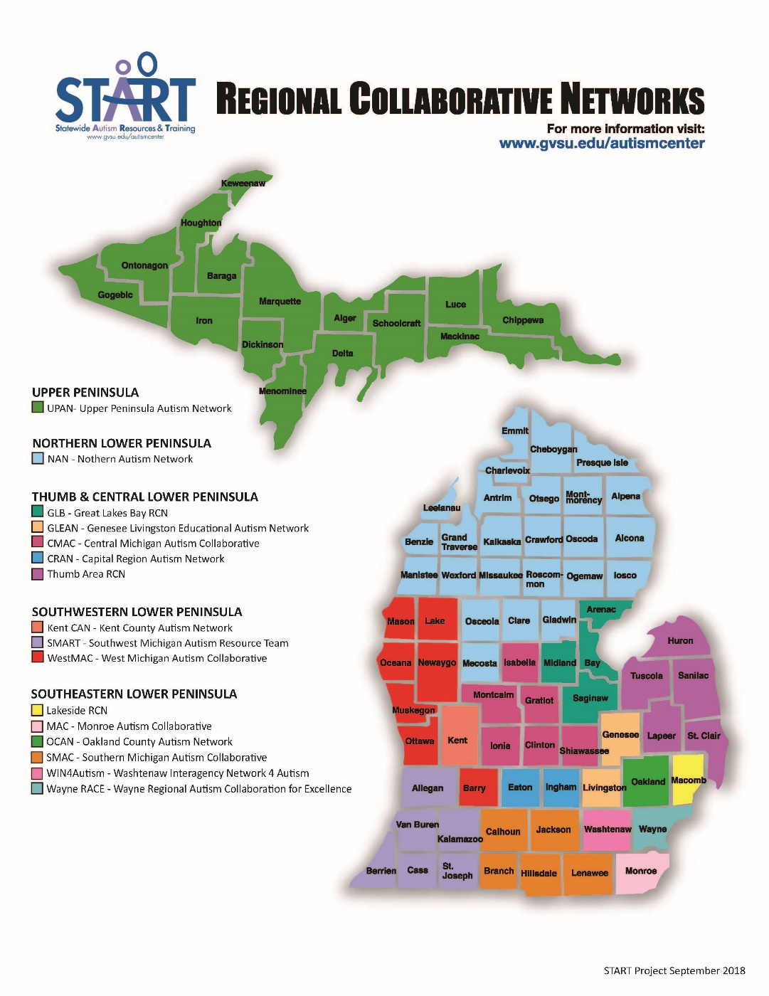

Slide 12
START - RCN Contract Goals
Goal 1: PD with Impact
Goal 2: Coaching for Implementation
Goal 3: Transition
Goal 4: Peer to Peer
Goal 5: Family Engagement

Slide 13
Upcoming Events
2018-2019 RCN Leadership Events
@ Kellogg Center in East Lansing
Fall RCN Leadership Day Monday, November 12th, 2018
Spring RCN Leadership Day
Tuesday, April 30th, 2019

Slide 14
EPLI Trainer Update
For Current
and Prospective Trainers
April 10th 2019
8:30 – 3:30
Crowne Plaza Grand Rapids

Slide 15
Tools & Resources

Slide 16
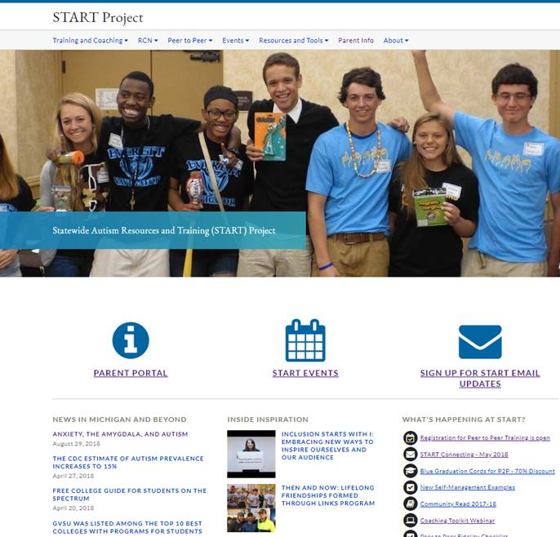
START website

Slide 17
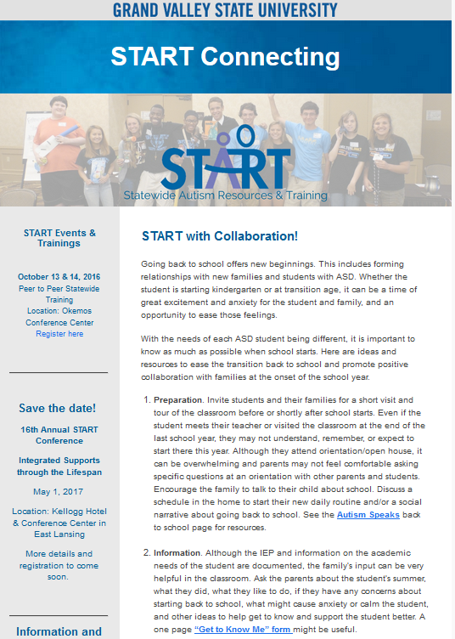
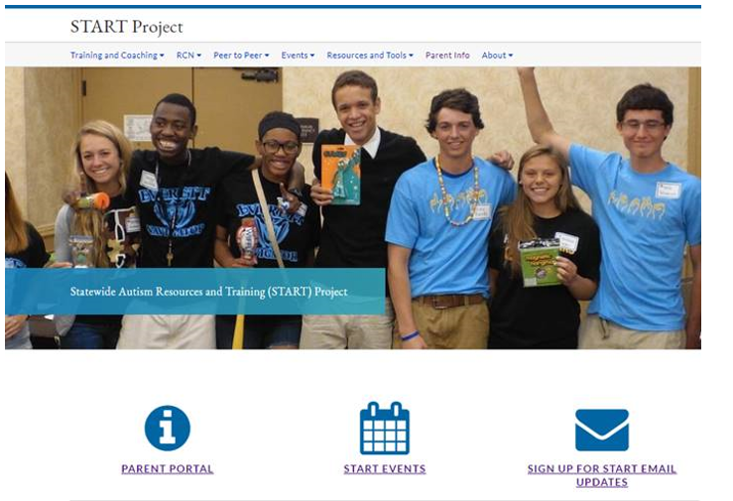
START Connecting

Slide 18


Find START on Social Media
Facebook STARTProjectMI
  Closed RCN Group (START Project – RCN Group)
Twitter: @STARTProjectMI
Hashtag: #STARTProject

Slide 19
New Meeting Mechanics Manual
New Section: Effective Teaming
  Meeting Essentials
  Meeting Practices
  Individual Meeting Accountability
Meeting Mechanics Process
Meeting Mechanics Resources
  Guiding Principles
  Visual Organizers & Tools
SPECIAL: Buy old manuals for 50% off
Contact Kellie Fitzgerald

Slide 20

The START Passport

Slide 21
Parent Resources
Website
School Services Brochure
Passport

Slide 22
Family Engagement
START Parent Liaisons
Collaboration with Michigan Alliance for Families

