Slide 1
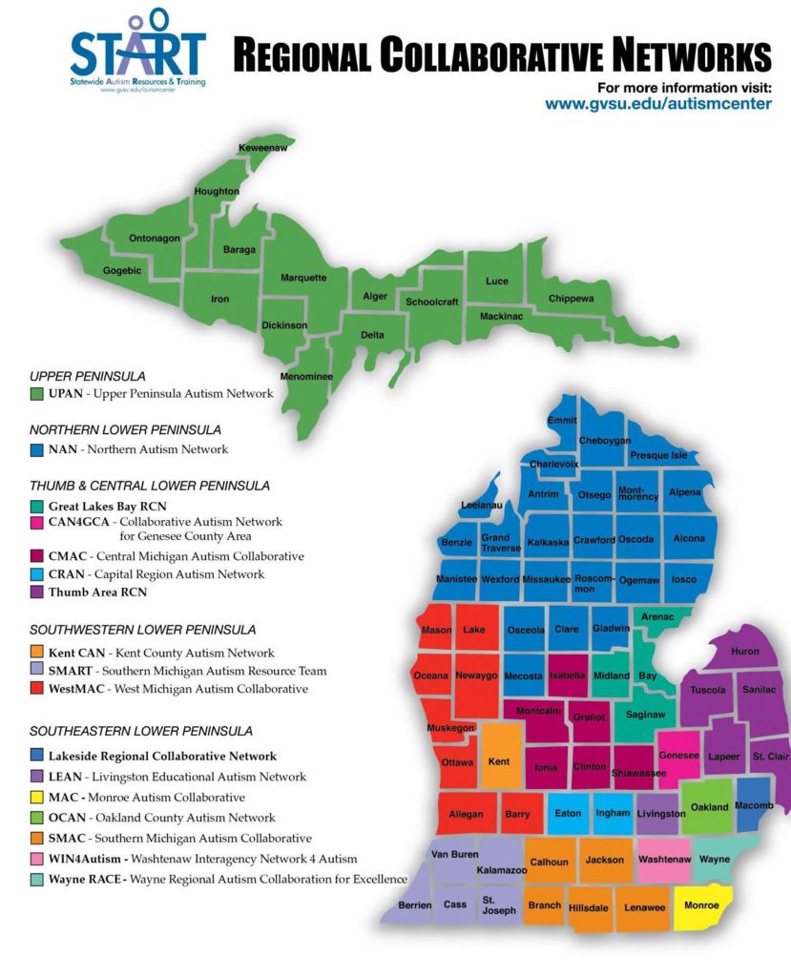
Regional Collaborative Networks Fall Update September 2015
Notes:
Review updated map and indicate it can be found on the website, if needed.

Slide 2
National Updates: 40th Anniversary of IDEA

Slide 3
40 Years Later
Students with significant support needs (e.g. CI, ASD) acquire more skills when they receive their instruction along side same age, non-disabled peers.
(Ryndak, et. al., 2013)

Slide 4
State Updates: Office of Special Education (OSE)
Focus Areas for Projects:
Demonstrating Academic Growth
Literacy including Early Childhood
Family Engagement
Disproportionality
2020 Federal Youth Transition Plan

Slide 5
Updated Concepts in Ed Strategies: Academic Growth / Literacy Behaviors Associated with Learning (“turn paper in”)

Slide 6
Is the Student Taking State / District Reading Assessment(s)
Yes
No
Proficient?
Enhanced Assessment
Proficient?
Decision-Making Process
Yes
No
Carry On
Yes
No
Teaching Strategies

Slide 7
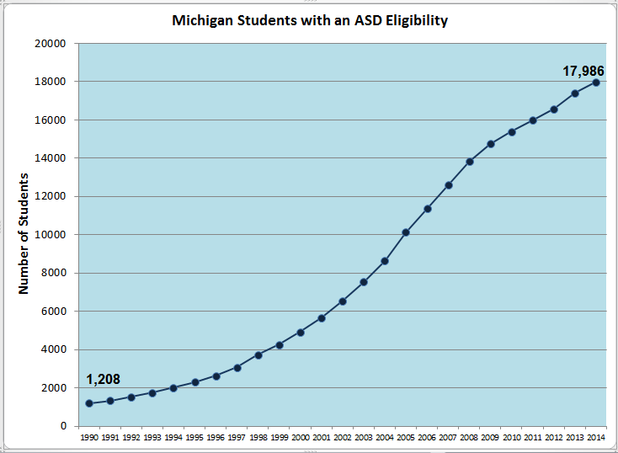
Michigan Updates
Notes:
Increase of only 29 from 2013

Slide 8
Michigan Updates
Insurance and Medicaid Coverage
http://www.michigan.gov/autism
The Autism State Plan
http://michigan.gov/autism
The Autism Council

Slide 9
Autism Council
SUBCOMITTEES
Early Intervention
Adult Services
Education
Workgroups
Screening and Evaluation for ASD
Education-Based Evaluations
Standards for Secondary Transition Programs

Slide 10
Education-Based Evaluations for ASD Document—Autism Council APPROVED
Autism Council Link
http://www.michigan.gov/autism/0,4848,7-294-63678_70839---,00.html
START CET Link
http://www.gvsu.edu/autismcenter/cet-centralized-evaluation-team-module-96.htm

Slide 11
CET Expansion Components
The New Reality in Evaluations for ASD
More Kids
Additional Players: Autism Insurance Benefit
Increasing Complexity
Expanded MARSE Eligibility Criteria
Contextual Application of CET
Differential Eligibility

Slide 12
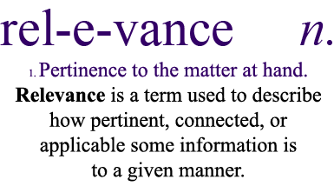
Recommendations for Secondary Transition Programs

Slide 13
START Updates

Slide 14
www.gvsu.edu/autismcenter
Notes:
START is staying green so will post as much as possible on the website.
Show participants where to find info on website, including this powerpoint.

Slide 15
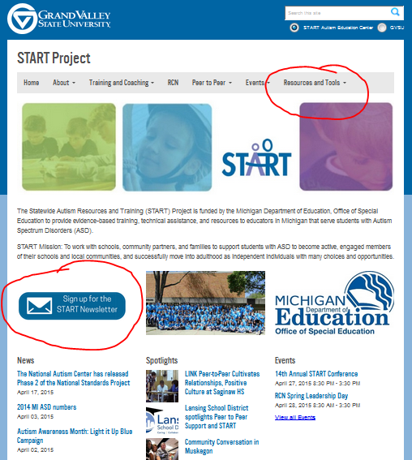
START Newsletter: Bi-Monthly

Slide 16
We’re Online!!
Twitter: @STARTProjectMI
Instagram: startpeertopeer
Hashtag: STARTProject
Facebook
“Like” our page (Statewide Autism Resources and Training (START))
Closed RCN Group (START Project – RCN Group)

Slide 17
START RCN Facebook Group
Closed Group
Purpose: RCN Rep Communication & START Updates
HOW TO “LIKE”: START rep will open site briefly at RCN meeting so reps can “like” the page. START rep will then close the site again. Those not present will need to request to “like” the page.
Notes:
Discuss the move to using more social media (e.g. twitter, instagram and Facebook). Discuss purpose of this page and allow reps to “like” the page while at the meeting.

Slide 18
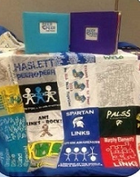
START Peer to Peer Quilts
Send us your new peer to peer t-shirts for the next quilt!
To check out the quilts for your next event, go to the START website under Peer to Peer!!

Slide 19
Peer to Peer Manual Purchase

Slide 20
2015-16 START IT Sites
Early Childhood
Macomb w/ St. Clair
Eaton/Ingham
K-12
SMAC (Jackson)
Ottawa
Building Your Future (BYF)
Oakland Schools

Slide 21
Due to Popular Demand 2016-17 START IT Sites
So many applications for ‘15-16…
All or Most Early childhood, K-12, and BYF sites may be confirmed for ‘16-17

Slide 22
Upcoming Statewide Trainings
Peer to Peer: September 29 & 30 @ Grand Rapids Crowne
Self-Management:
October 27th, 2015 @ Grand Rapids Crowne
November 9th, 2015 @ Lansing Crowne
Content:
Driven by Presenting Problem
Problem-Solving Questions
LOTS of Examples
Register on the START Website under “Events” (www.gvsu.edu/autismcenter)

Slide 23
We’re Taking a Hiatus on Stand-Alone Training Requests
Why?:
Time and Other Priorities
Outcomes of stand-alone modules
Not Included:
Peer to Peer
New Modules (Self-Management)
EPLI Trainer Focused Modules
Options:
Utilize EPLI Trainers
Mini Trainings during RCN Meetings

Slide 24
Focus of Mini-Trainings

Slide 25
Technical Assistance (TA)
Peer to Peer Support TA Application http://www.gvsu.edu/autismcenter/peer-to-peer-support-2-140.htm
(bottom of the page)
Community Conversations TA Application http://www.gvsu.edu/autismcenter/building-your-future-project-139.htm
(bottom of page)

Slide 26
2015 Fall Leadership
November 2nd
Morning:
START Updates & 15 Year Celebration
Corey Smith from Griffin-Hammis
Afternoon:
Transition Follow Up
Peer to peer models (Lisa Basore, EUP)
Literacy

Slide 27
START Conference 2016 May 2, 2016 @ Kellogg Center, East Lansing
KEYNOTES PRESENTERS:
Stephen Shore
Dan Habib
Alyson Beytein

Slide 28
RCN Spring Leadership 2016
May 3, 2016 @ Kellogg Center, East Lansing

Slide 29
RCN Priorities 2015-16
Professional Development with Impact
Coaching for Implementation of EBP
Secondary Transition
Peer to Peer Support
Family and Community Engagement

Slide 31
START Data Tools for ‘15-16 Embedded in Priorities / Processes
Universal Supports Assessment and Planning Tool (USAPT 2.0)
Classroom Environment and Teaching Assessment (CETA) Tool
Individual Student Data Collection
Independence
Engagement
Social interaction
Target Student Data Forms (K-12 / BYF) to use at baseline and end of year

Slide 32
RCN Application Priority Changes for 2015-2016
Coaching – Use of NEW Coaching Checklist
USAPT Data
Reporting of Target student data (independence, engagement, social interaction, academic growth)
SELECT TARGET STUDENT AND
COMPLETE BASELINE DATA EARLY!!

Slide 33
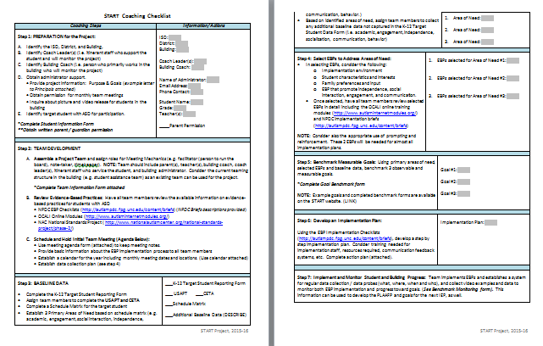
NEW Coaching Checklist

Slide 34
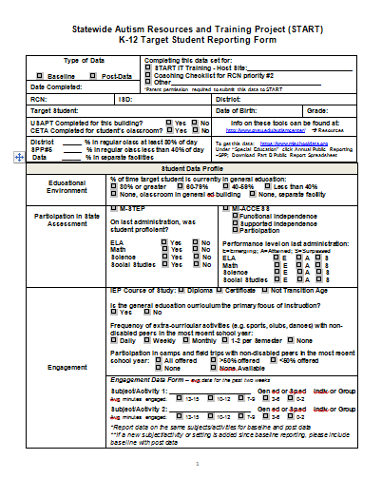
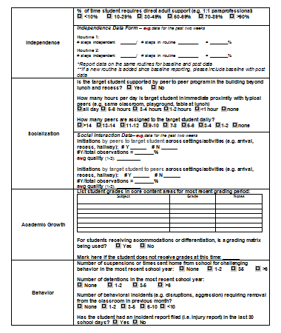
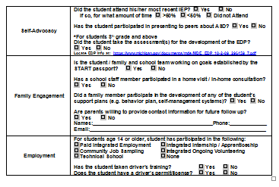
Target Student Data Form

Slide 35
http://afirm.fpg.unc.edu/afirm-modules

Slide 36
2014-15 Requirement EBP Videos Give to START RCN Rep on Flashdrive or share through Dropbox or Google Drive

Slide 37
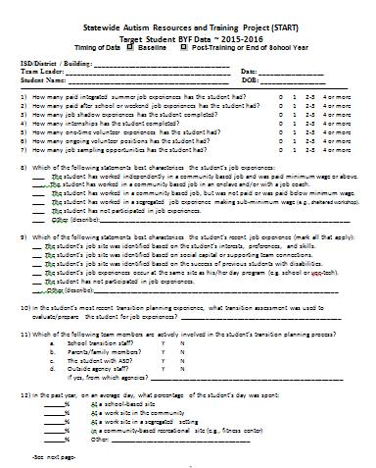
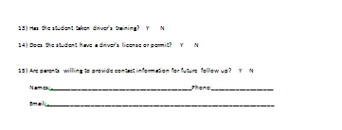
Priority Changes: Secondary Transition Data Reporting Form

Slide 38
RCN Priority Additions
Family & Community Engagement
Parent mentors from Michigan Alliance for Families involved with RCN
Use Passport w/ families/students

Slide 39
Family Collaboration
MAF (Michigan Alliance for Families) http://www.michiganallianceforfamilies.org/
Reps on RCNs
For special education questions
The Family Center for Children and Youth with Special Health Care Needs
http://www.michigan.gov/mdch/0,4612,7-132-2942_4911_35698-56603--,00.html
Scholarships
Parent mentor trainings
AAOM (Autism Alliance of Michigan) https://autismallianceofmichigan.org/
For insurance coverage information
Navigator

Slide 40
The XTREME RCN CHALLENGE
Passport & USAPT

Slide 41
Passport Dissemination by ISD
Number of Passports determined by the number of students with ASD in the ISD
More available if all distributed are logged on Passport Google form

Slide 42
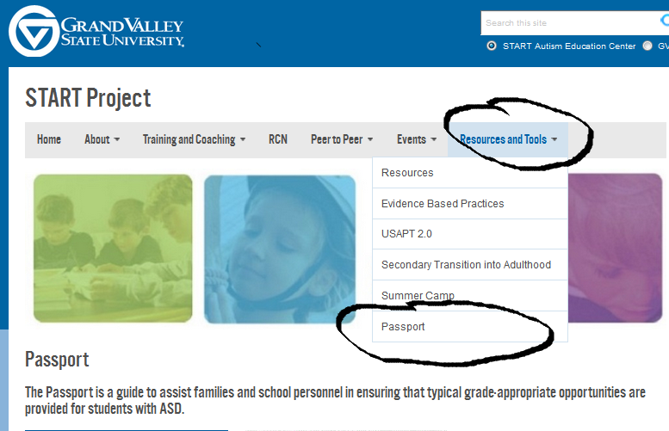
Passport Webpage

Slide 43
Passport Extreme Challenge Process
☹ DO NOT JUST PASS THEM OUT☹
For each passport utilized, complete the Google sheet for each passport including using the checklist (http://www.gvsu.edu/autismcenter/passport-216.htm)
RCN Winner: % of google forms completed based on number of Ss with ASD

Slide 44
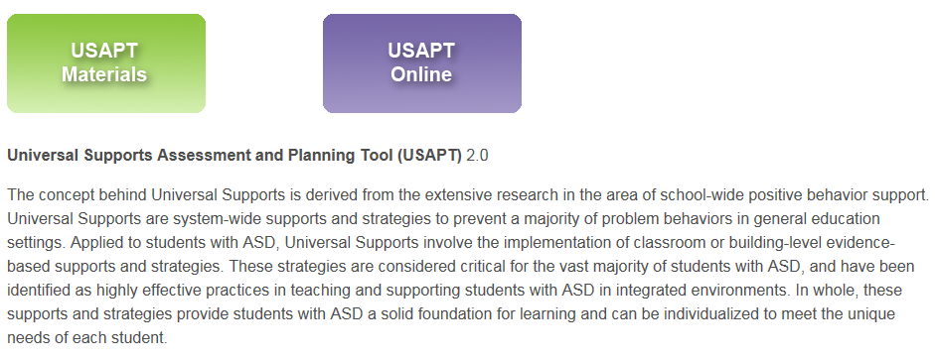
USAPT Extreme Challenge Process
# Buildings with USAPT completed at least once in the year

Slide 45
EPLI Accurate Trainer List

Slide 46
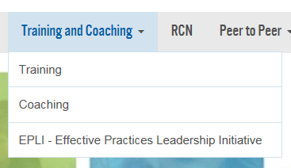
Trainer Process www.gvsu.edu/autismcenter

Slide 47
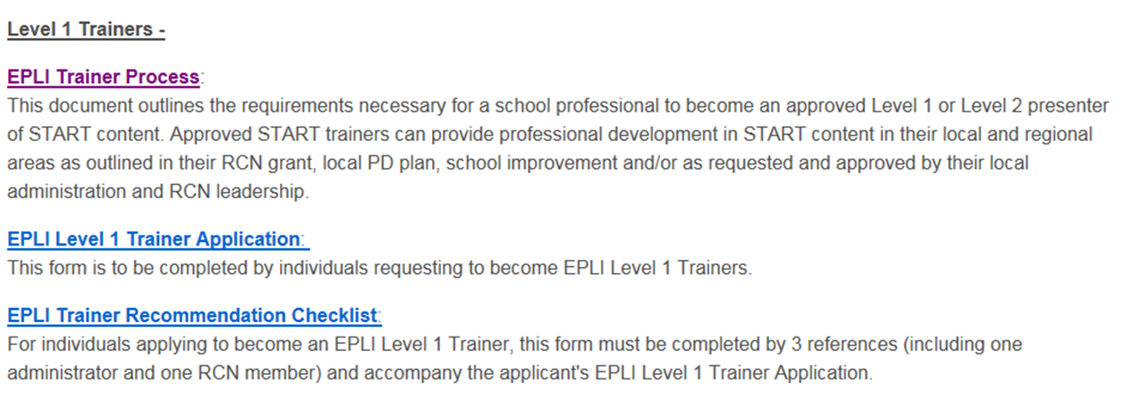

Slide 48
Mid Year and End of Year Report
All forms for the mid and end of year report are on the website under RCN → RCN Application and Report Forms
See updated Report – more concise and most of the data is captured on attached forms
Check your RCN Dropbox for your Peer to Peer logs from 14-15 and a slightly updated Capacity Building Tool (available by late fall)

Slide 49
RCN Contract Financial Reporting
Fidelity of the contract
Report spending by budget category
Connect spending to goals
Written approval required if you deviate 10% or more from line item
Financial Expenditure Report Template and Sample

Slide 50
Using Dropbox
-- RCN reporting forms for each RCN
CAUTION:
--Copy and Paste (don’t cut and paste or the item will be removed from its original location)
--Don’t work on docs at the same time—it will only save one version

Slide 51
RCN Communication Plan and 2015-16 Calendar
Notes:
Be sure you have an accurate listserv or email group for communication.

