Slide 1
Center Program Transition Kent ISD Secondary Transition Priorities
Paul Dymowski

Slide 2
Center Program Transition Update
Collaboration with GRPS and KISD
Staffing Timeline
Policies and Procedures
Continuous Improvement
Location Considerations

Slide 3
Center Program Locations
Location Constants
Location Considerations
Lincoln School
Lincoln Developmental Center
Pine Grove Learning Center
KEC Oakleigh
KEC Beltline
Community Transition Campus
Mayfield Building
Straight Building
Community Sites
Ken-O-Sha Home Community
Early Childhood Special Education Center @ Campus
Grand Rapids Oral Deaf

Slide 4
Secondary Transition
Bill Behrendt – New Kent ISD Supervisor

Slide 5
Transition System
Student Focused Planning
Family Engagement
Program Structures
Interagency Collaboration
Student Development

Slide 6
Kent InterAgency Collaborative (KIAC)

Slide 7
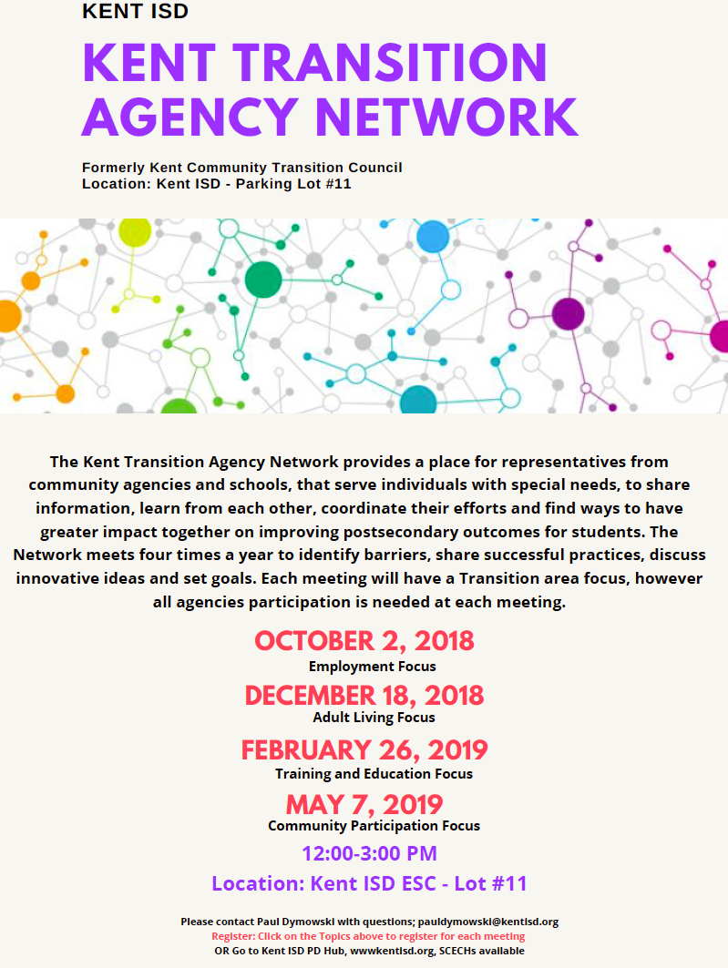

Slide 9
Transition Expo
March 7, 2019
5:00-7:00
@ Kent Transition Center
Employment Agencies

