Slide 1
What is Kindergarten Readiness?
Laura Schumacher, M.ECE, Early Childhood Specialist
Rachel Pond, M. Ed, Early Childhood Specialist
Notes:
Together

Slide 2
Kindergarten Readiness:
at a Glance
Academic: alphabet, know a few letters, and can count to 10
Fine Motor Skills: like holding a pencil correctly and using scissors
Self-Care: getting dressed and bathroom independence
Notes:
Laura
“Guidance”
Children with disabilities and developmental delays are still ready for kindergarten- teachers will meet them where they are.

Slide 3
Here are some things to consider if you’re wondering whether your child is ready for kindergarten:
Can your child communicate?
Can your child learn independently and with others (adults/peers)?
Can your child manage emotions?
Does your child know some letters and numbers?
Can your child use fine motor skills and large motor skills?
Notes:
Rachel

Slide 4
How I Communicate
Use words to ask and answer questions
Listen to a follow 2 to 3 step directions
Sing songs and do fingerplays
Express thoughts, feelings and ideas
Carry on a short conversation
Use rhyming words
Notes:
Laura
This falls under language development. Here are some things you can do at home to support your child’s language development:
Ask who, what, where, when and why questions (in car, walking, store, etc)
Have conversations and explain why
Listen to child’s words
Talk about all feelings

Slide 5
How I Learn
Solve problems
Explore and explain actions
Continue trying at tasks
Try new activities
Use imagination
Use senses
Notes:
Rachel
This falls under approaches to learning. Here are some things you can do at home to support your child’s learning:
Engage in and expand learning together
Use senses when learning
Allow extra time to solve problems
Minimize screen time to increase more hands-on learning (0 minutes until 2 years old, 2-5 years old 1 hour per weekday)

Slide 6
How I Use My Emotions
Engage with other children in pretend play
Use a predictable routine
Manage emotions with help
Separate easily from family members/loved ones
Wait and take turns
Respect and care for others (feelings, space, differences)
Notes:
Laura
This falls under social emotional development. Here are some things you can do at home to support your child’s social emotional development:
Model managing emotions (taking deep breaths, having time alone, modeling calmness)
Label feelings (happy, sad, mad, afraid, lonely, etc)
Use consistent bedtime routine

Slide 7
How I Use My Brain
Touch and count objects to 10
Sort objects (size, shape, color)
Write some letters
Recognize numbers 1-10
Recognize one’s own name in print
Notes:
Rachel
This falls under cognitive development. Here are some things you can do at home to support your child’s cognitive development:
Teach letters in name
Count items out loud altogether and by touch
Sort items together by shape, size and color
Play games together using letters or numbers

Slide 8
How I Use My Muscles
Hold and use pencils and crayons
Open snacks and food wrappers
Get dressed (button, snap, zip, shoes, gloves)
Take care of personal needs (use bathroom, wash hands, brush teeth, use a tissue)
Be active (jump, run, climb, hop, throw, kick, catch, balance)
Cut with scissors
Pick up small objects
Notes:
Laura
This falls under physical development. Here are some things you can do at home to support your child’s physical development:
Show how to use scissors
Encourage to dress self
Be active outside
Plan enough sleep and healthy food options with meals

Slide 9
Success Basics For Kent County
Notes:
Rachel
Success Basics video linked in image

Slide 10
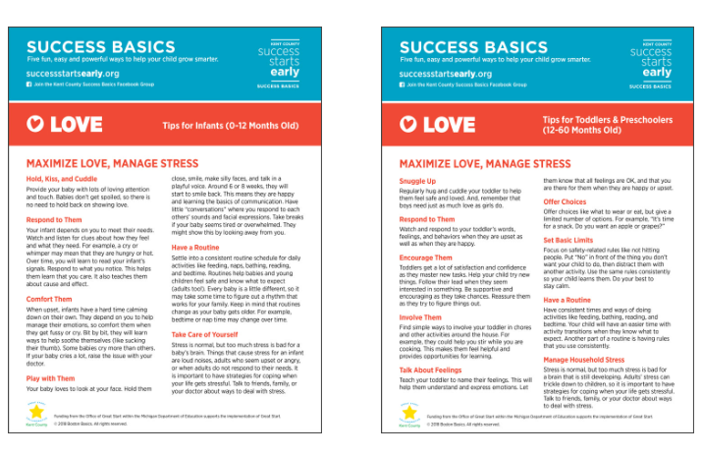
Love
Maximize Love
Minimize Stress
Notes:
Laura
Tip sheets for 0-12 and 12-60 months
Babies and toddlers thrive when their world feels loving, safe, predictable. Respond with smiles, words and touch to help them see, hear, and feel your love. You will help them develop a sense of security and self-control.
Have your child help you prepare dinner
Spend time outside together. Spread out a blanket, and look at the clouds/sky.

Slide 11
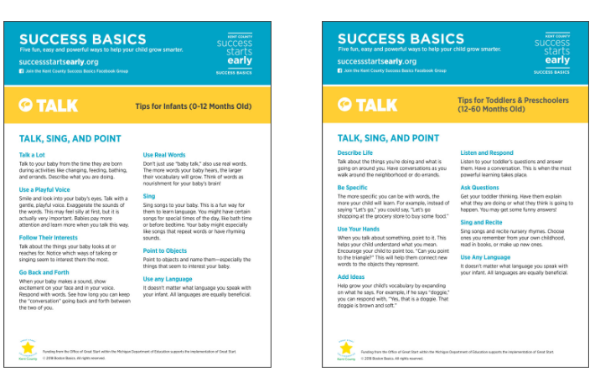
Talk
Sing and Point
Notes:
Rachel
Babies learn language from the moment they are born. Respond to their sounds and, later, their words. Connect through eye contact and a loving tone of voice, while pointing to help them know what you are talking about.
Say and do the motions to one of your favorite rhymes. Rhymes is a first stepping stone to reading later on!
Make up your own verses for the song, “if you are happy and you know it”

Slide 12
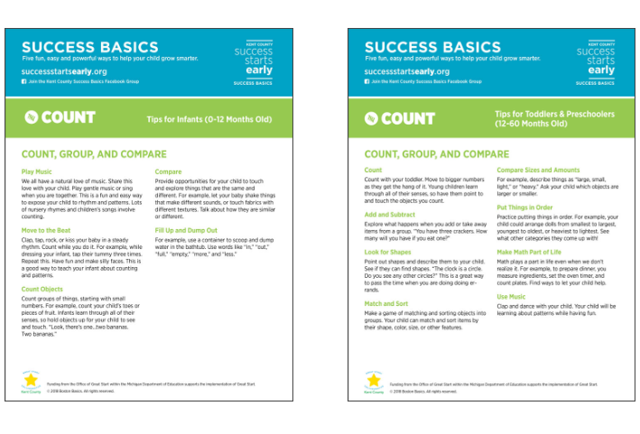
Count
Group and Compare
Notes:
Laura
Every child’s brain is wired for math. Talk about numbers, shapes, patterns and comparisons as you go about your routines together. Watch your child learn to love math!
Help your child clap to the beat as you listen to a song.
Count a basket of objects together and sort them into related groups/categories

Slide 13
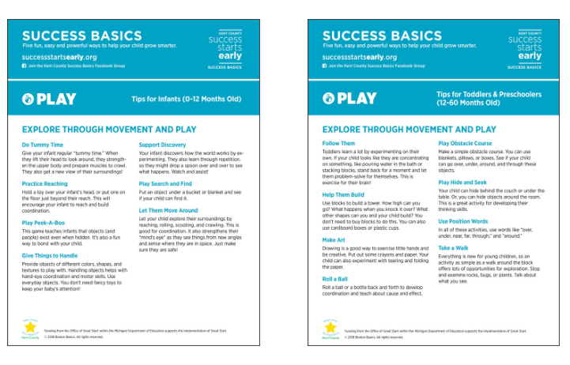
Play
Explore through Movement and Play
Notes:
Rachel
Babies are like scientist who love making discoveries. Watch to see what interests you child, then encourage their curiosity and help them learn when they play and explore.
Put on a puppet show using stuffed animals, or make your own sock puppet.
Get out spoons and pots to make a kitchen band.

Slide 14
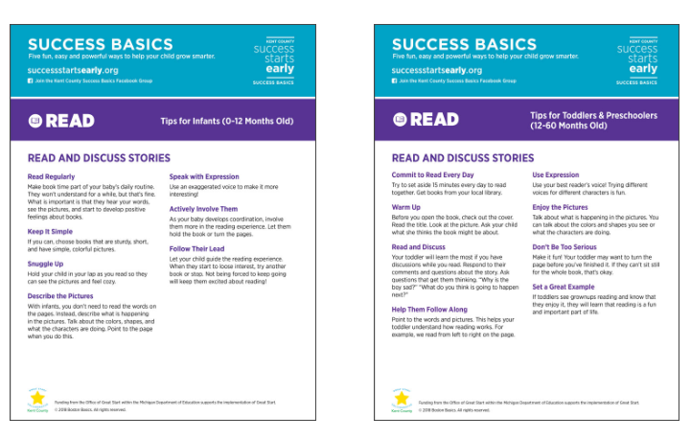
Read
and Discuss Stories
Notes:
Laura
Reading turns kids into confident thinkers. Make books a regular part of your relationship from the very beginning. With infants, point at the pictures and speak with excitement. With toddles, just make it fun.
Read a story and ac tout movements to some of the actions words.
While reading, describe the pictures, talking about colors, shapes, and characters

Slide 15
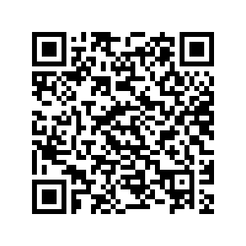
What does Michigan Department of Education (MDE) Say?
Age requirement
Readiness
How families can support
Kindergarten daily routine
How to engage as a family member
Website: https://www.michigan.gov/mikidsmatter/parents/pre-k/faq-transition-to-kindergarten
Notes:
Rachel
Age requirement
If your child meets the age requirement (five years old by September 1), they may enroll in Kindergarten. There is no entry test for Kindergarten.
Readiness
Most children are ready by age five, so it is likely that your child will be, too. The important part of making sure they are ready is for families and teachers to work together to make sure each child feels confident and ready to learn.
How families can support
Family support is the most important factor to make your child feel safe and ready for school. Do things like: keep a daily routine and make sure they have plenty of play time. Read to, play with and listen to your child. Also, make sure your child’s shots and health checkups are current.
Kindergarten daily routine
Your child will have active and quiet activities, in large and small groups. There will be time for your child to work alone on projects. There will be a snack time. Also, there may be extra classes such as gym, music, art, library, computers, etc. Ask your teacher for a sample daily routine.
How to engage as a family member
Being engaged in your child’s school helps them succeed. There are many ways to become involved. You can volunteer at the school, join the PTA, or serve on a committee. You can read and respond to the school notices or newsletters. You can also be involved simply by helping organize your child’s time, helping with homework, and talking to them positively about school.

Slide 16
Opportunities in Kent County To Support Kindergarten Readiness:
Bright Beginnings Playgroups for 0-5 year olds: kentisd.org
Great Start Readiness Program for 4 year olds by Dec. 1: kentisd.org
Great Start to Quality for High-quality childcare programs: kentisd.org
1,000 Books Before Kindergarten: kdl.org
Parks, Free Events: grkids.com
Family Indoor Swim, Classes, Discounted Memberships: grymca.org
Family Futures: ASQ, Family Newsletters, etc. https://familyfutures.org/programs/connections/
Notes:
Laura

Slide 17
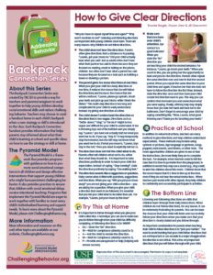
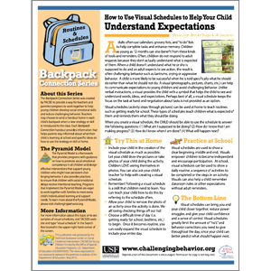
Family Backpack Connection Series
Website: https://challengingbehavior.org/collection/backpack-connection/
Help Your Child Have Successful Bedtime
Help Your Child Have Successful Morning
How to Help Your Child Manage Time and Understand Expectations
How to Help Your Child Transition Smoothly Between Places and Activities
How to Plan Activities to Reduce Challenging Behavior
How to Understand the Meaning of Your Child’s Challenging Behavior
How to Give Clear Directions
How to Help Your Child Stop Hitting and Pushing
Teachable Moments: How to Help Your Child Avoid Meltdowns
Recognize and Understand Anger, Disappointment, Fear, Jealousy, Sadness
Help Your Child Understand and Label Emotions
Help Your Child Learn How to Share, Trade, and Take Turns
Translations: http://cainclusion.org/teachingpyramid/materials/family/
Notes:
Rachel
READ: The Backpack Connection handouts that can be downloaded for free from challengingbehavior.org or https://challengingbehavior.org/implementation/family-engagement/#backpack. This can be used by teachers to help families understand the social emotional skills taught in the classroom and how they can be supported at home. They are available in areas of addressing behaviors, emotions, routines and schedules, and social skills. These family handouts are available in a variety of different languages. There are about 60 handouts to use at your convenience with individual families or to connect with your student’s families as a whole!

Slide 18
Free Apps for Phones or Tablets:
Sesame Street: App has over 100 games from math, science, to dealing with big feelings
Khan Academy Kids: kindergarten readiness outcomes for all kids!
PBS KIDS: child-friendly playing experience focused on science, math and creativity
Notes:
Laura

Slide 19
Key Takeaways
Kids develop skills at different rates and might have areas of strengths and areas in which they can grow.
If you’re concerned your child might not be ready for kindergarten, talk to your child’s preschool teacher or pediatrician about how to help.
Notes:
Rachel

Slide 20
Reach out if you have any questions or wonderings:
lauraschumacher@kentisd.org
rachelpond@kentisd.org
Notes:
Laura

