Slide 1
Kent Transition Agency Network
October 2, 2018
Employment Focus

Slide 2
Kent Transition Agency Network Purpose
The Kent Transition Agency Network provides a place for representatives from community agencies and schools, that serve individuals with special needs, to share information, learn from each other, coordinate their efforts and find ways to have greater impact together on improving postsecondary outcomes for students.

Slide 3
Agenda
12:00-12:30
Lunch and Networking
12:30-2:00 – Agency and School Staff
Identify Barriers
Share Successful Practices
Discuss Innovative Ideas
Set Goals
2:00-3:00 – School Staff
Transition Updates
Professional Learning

Slide 4
Employability Statistics National Longitudinal Transition Study (NLTS)
Employment during the years identified as emerging adulthood is associated with differences in psychological well-being and improved chances for a higher quality of life.
Young adults with learning disabilities (79 percent) were more likely to have a paid job than were those with
deaf-blindness (30 percent),
orthopedic impairments (38 percent),
visual impairments (40 percent),
traumatic brain injuries (44 percent),
autism(45 percent),
cognitive impairment (46 percent), or
multiple disabilities (46 percent)
People with disabilities have a much higher unemployment rate than the overall population

Slide 5
Employment
Barriers
Successful Practices
Innovative Ideas
Goals – Next Steps

Slide 6
School Staff

Slide 7
Technical Assistance – B-13 Guidance

Slide 8
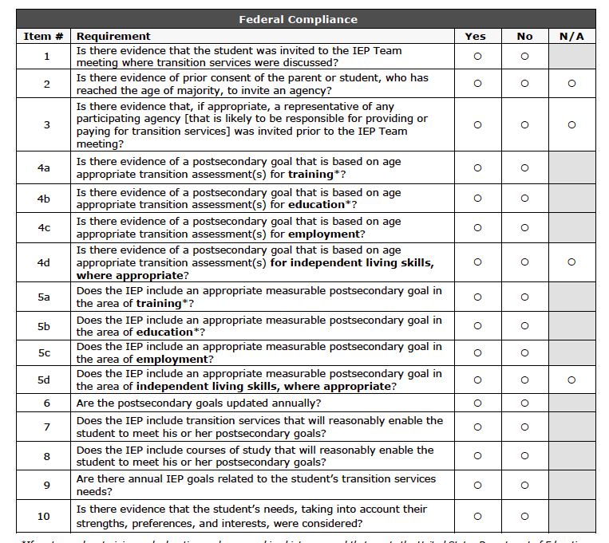

Slide 9
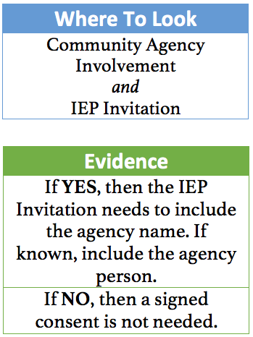
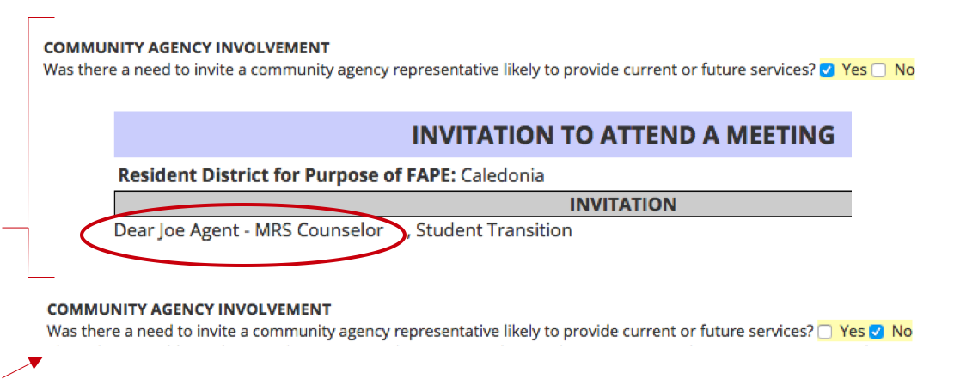
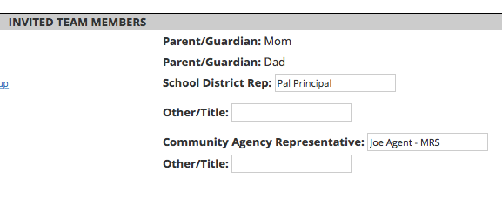

Slide 10
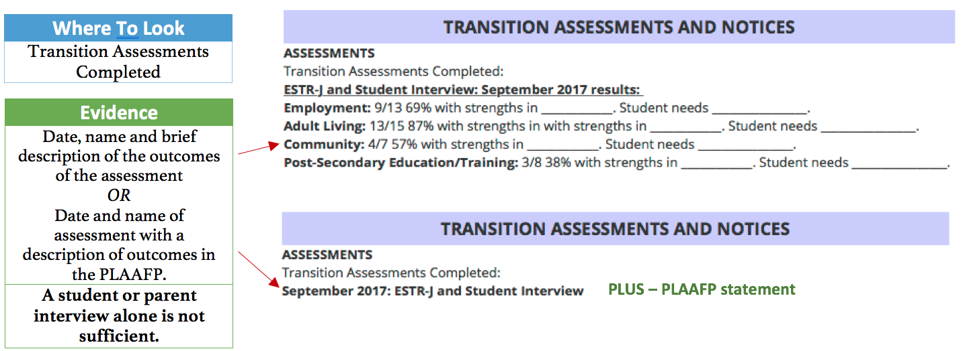

Slide 11
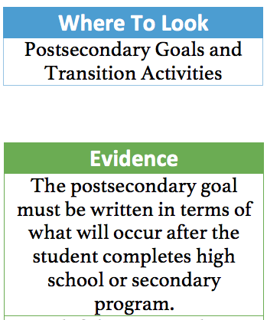

Slide 12
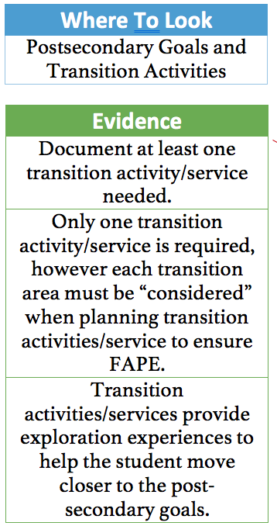

Slide 13
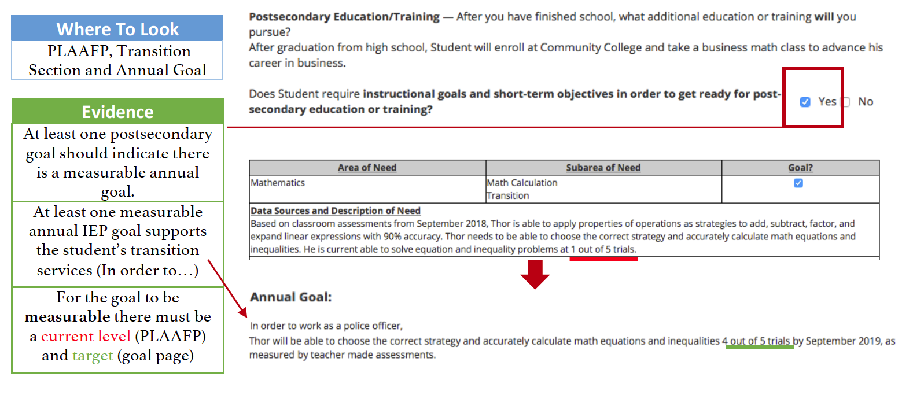

Slide 14
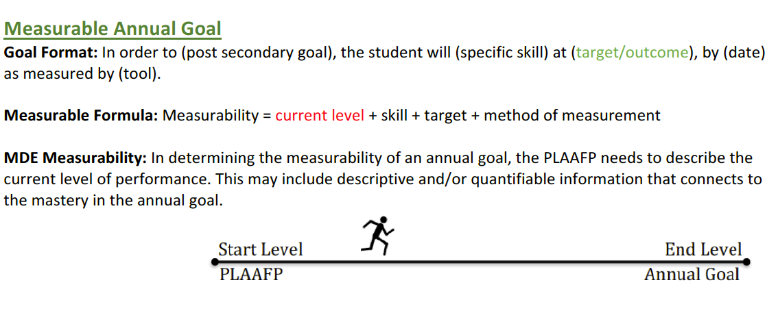

Slide 15
PLAAFP
Measurable Annual Goal
Specific Skill
the academic or functional skill that the student will do in observable and measurable terms
Target or Outcome
level of achievement or mastery that is expected for the specific skill; criteria data
Date
date that the goal will be achieved
Method of Evaluation
the tool that will be used to measure student’s progress towards meeting the goal
Specific Skill
the academic or functional skill that the student can do in observable and measurable terms
Current Level
current level of performance of the specific skill is the starting point; baseline data
Date
date of baseline assessment
Method of Evaluation
the tool used to obtain baseline data and starting point for instruction

Slide 16
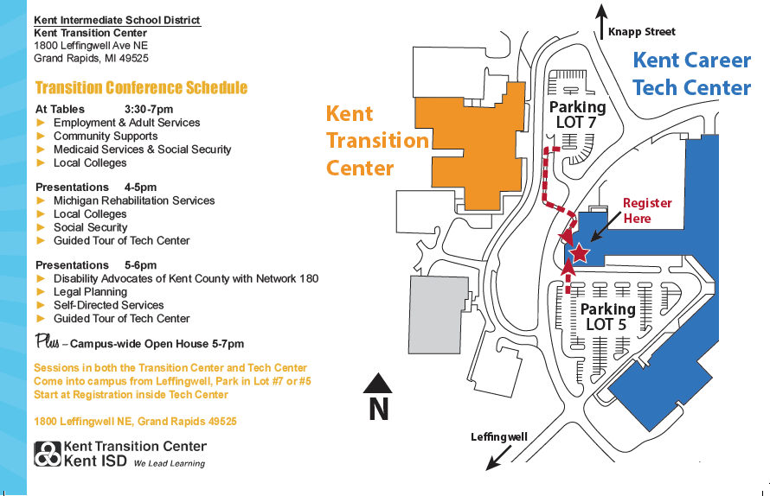

Slide 17
November 26, 2018 2nd and 3rd Sessions

Slide 18
Student Conference – GRCC March
STUDENT TRANSITION CONFERENCE AGENDA
8:25 - 8:55 | Buses arrive at the GRCC Student Community Center, REGISTRATION AND REFRESHMNETS
8:55 - 9:00 | Welcome!
9:00 - 9:45 | Keynote: “. . . take your future by the reigns - right now” Ryan Hipp, author/illustrator of books for kids
9:45 - 9:50 | Instructions for the day
9:50 – 10:00 | Move to Applied Technology Center (ATC)
10:00 - 10:30 | Session I - Career Connections
10:35- 11:05 | Session II - Career Connections
11:10 - 11:40 | Session III – Community Connections
11:45 – 12:30 | Lunch – student center cafeteria DJ : EOB from WSNX and PRIZES
12:30 | DEPART

Slide 19
Reflection and Feedback

