Slide 1
Kent Community Transition Council (CTC)
January 30, 2018
Welcome!!
Please sit by someone new to you

Slide 2
Agenda and Outcome
Agenda
Outcomes
Welcome and Network
Agency Showcase – Ability Employment Services
Agency Reports and Updates
List of Kent County Agencies – Review and Update
Transition Events
Transition Expo
MiCareer Quest
MDE Memo – Inviting Agencies
Guidance for Districts
Transition System – 2018-2019 Plan
Family Engagement
Student Development – Focus son Social Development
CTC members will grow in their understanding Kent County Transition System so that we can ensure positive outcomes for all students
CTC members will develop a plan for next school year

Slide 3
Agency Showcase

Slide 4
Agency Reports and Updates
Around the Room
Review Updated Agency Resource and Website

Slide 5
Transition Events
Transition Expo
March 8 @ KTC
https://youtu.be/96Dj72-sQ9o
MiCareer Quest
April 25 @ Devos Place
https://www.youtube.com/watch?v=lHxlVFeYxjI

Slide 6
Transition Expo
Schedule
3:30-7:00 » Exhibitors
Employment Services
Adult Services
Community Supports
Medicaid Services
Social Security
Colleges
4:00-5:00 » Presentations
Michigan Rehabilitation Services
Local Colleges
Disability Advocates of Kent County and Network 180
5:00-6:00 » Presentations
Michigan Rehabilitation Services
Social Security
Legal Planning
5:00-7:00 » Open Houses
KTC and KCTC
Kent Innovation High School
My School @ Kent
March 8, 2018
3:30-7:00
@KTC
All students with IEPs
Little supper provided

Slide 7
MDE Memo – Inviting Participating Agencies
New standard of evidence for inviting agencies
When do you need to invite agencies

Slide 8
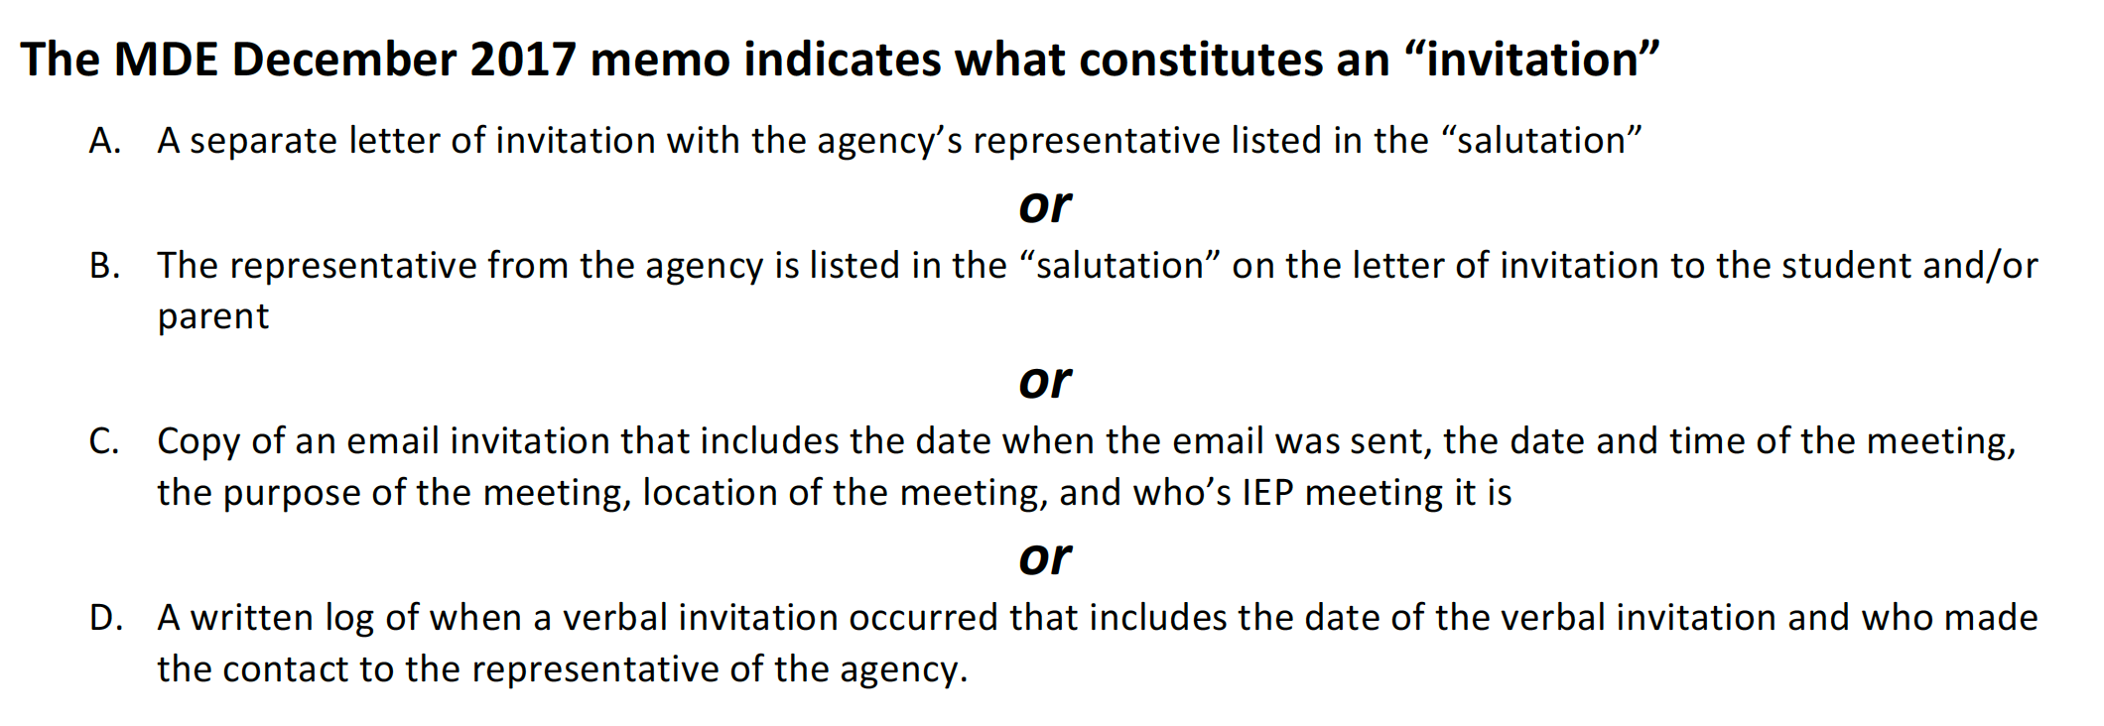
B13 – Question #3 – MDE Memo of Agency Invite

Slide 10
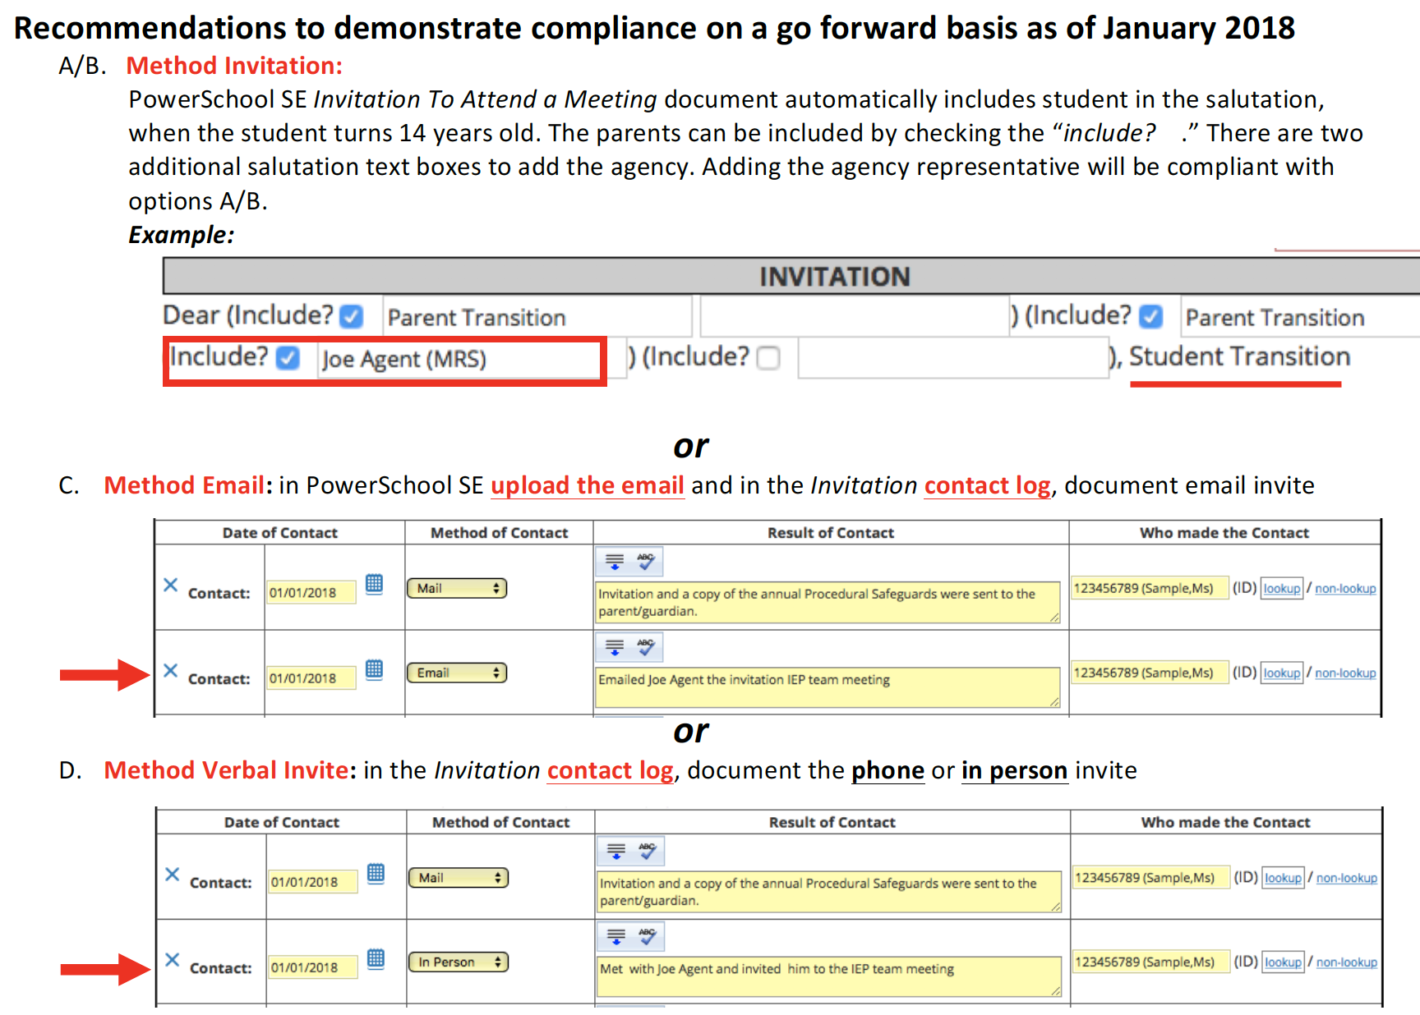

Slide 11
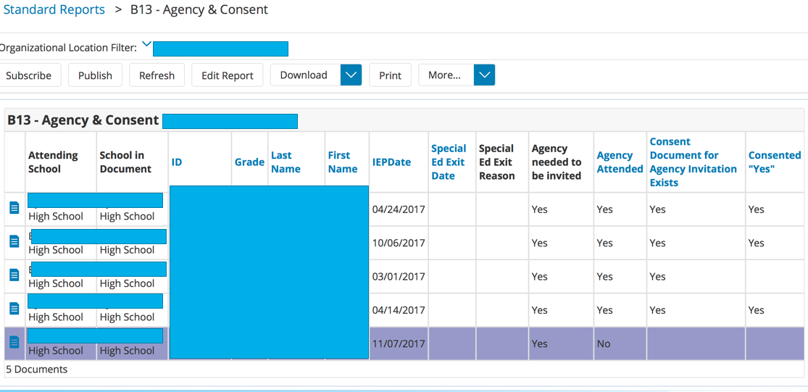

Slide 12
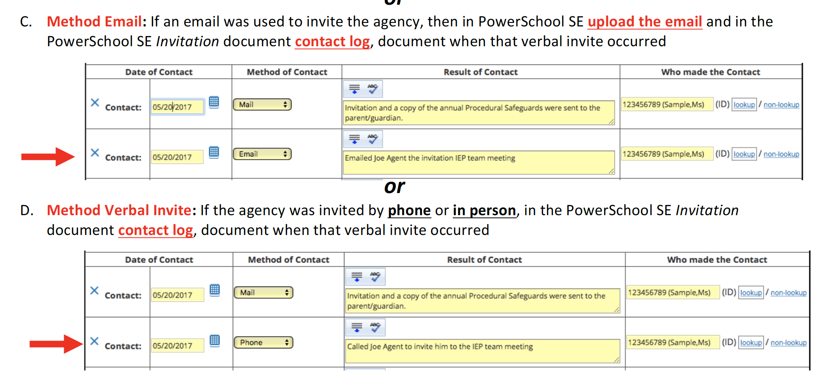

Slide 13
MDE Memo – Inviting Participating Agencies
The law does not define when services are to be delivered or paid (such as, within the IEP year, 2 years out, 4 years, etc.). It simply states “if it is likely” that the outside agency will provide or pay for service – but not when.
So, some interpret this to mean if the IEP Team decides that MRS is needed (at any time in the student’s high school career) then they should be invited. Others interpret this to mean within the IEP year.
Without a clearly defined timeline, we are leaving it to the IEP team to determine if an outside agency is likely to pay for or provide services.
However, the IEP Team must be careful. If the Team indicates on the IEP that an agency is likely to provide or pay for services, they cannot defer it to a later date/time. Once it is established that an agency is likely to provide or pay for transition services, then they must be invited to the meeting.

Slide 14
Transition System Continuous Improvement for Student Outcomes

Slide 15
Transition System
Student Outcomes
Student Focused Planning
Family Engagement
Program Structures
Interagency Collaboration
Student Development
IEP Development
Student Participation
Career/Transition Assessment
Skill and Behavior Development
Student Supports
Family Involvement
Family Empowerment
Family Preparation
Program Evaluation
Evidence Based Practices
Collaborative Framework
Collaborative Service Delivery

Slide 16
Today’s Goal: Identify What is Working and Needs
Positive Outcomes for Students
Purposeful Planning
Effective Intervention
Effective Implementation

Slide 17
Meeting Outcomes
November Meeting
January Meeting
What is working (existing services)?
What is an area of need?
Brainstorm: Solutions – Activities - Events
Resources needed
Brainstorm Solution that this group can help implement
Develop a plan for next school year

Slide 18
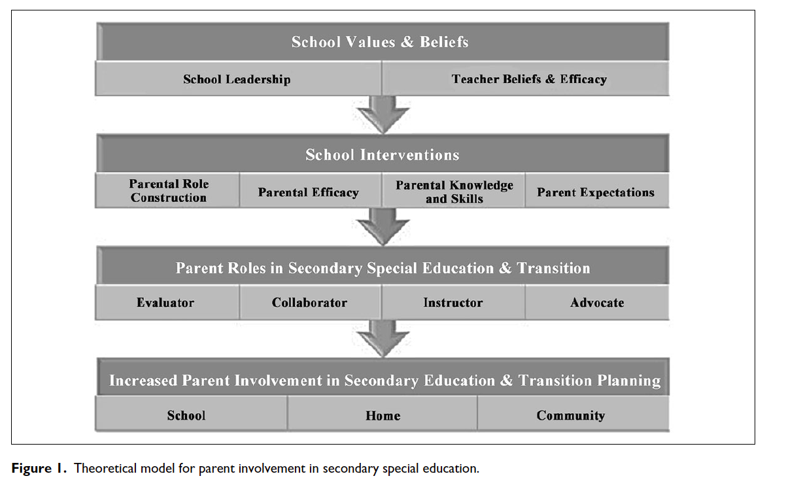
1. Family Engagement

Slide 19
Family Engagement
Working/Existing | Needs | Brainstorm | Resources
Newsletters | Sell the expo more | good participation at KTC open house | Need more parent frinedly resources
Email | agency navigation is difficult | Communication plan - | Comparison chart - diploma vs vocational track
Expos | parent struggle themselves | SSI and guardianship are important topics | A #411 for transition
 | parent involvement at IEPs | Not singular events (create community)
 | Empower parents and build skills | Need awareness level and explore level events and resources

Slide 20
Family Engagement
Table Groups
Brainstorm: develop a list of events, services, activities that this group could implement next school year
Whole Group
Each member select the top 3 ideas
Use the circle stickers to indicate your choices

Slide 21
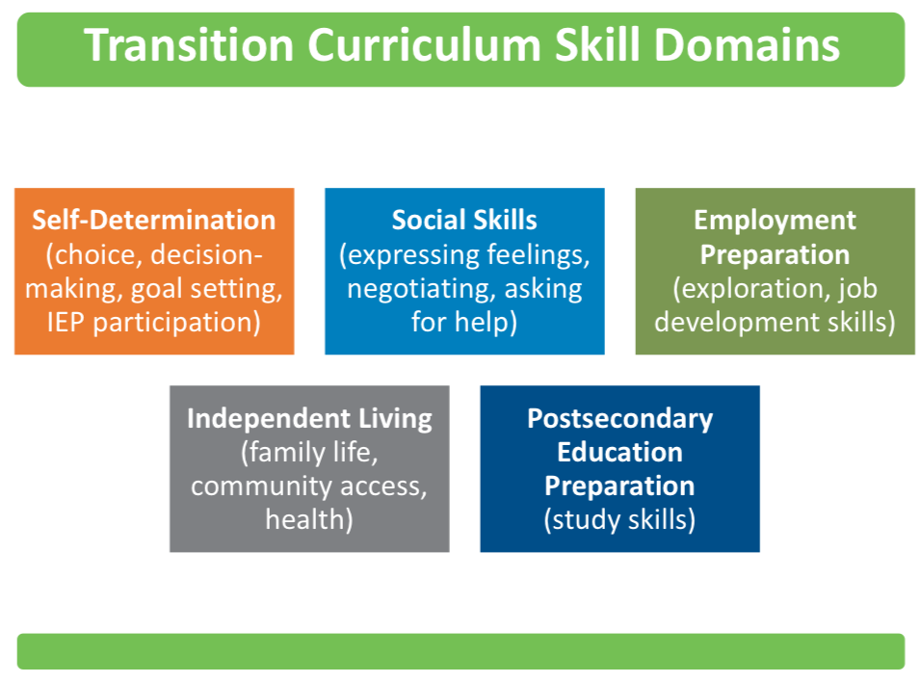
2. Student Development

Slide 22
Student Development
Working/Existing | Needs | Brainstorm | Resources
PBIS K-12 - teaching expectations | Soft skills training - more intensive and how to apply | develop instructional program between 11-12 grade | family involvment and support
peer to peer | Boundries - peers, bosses, landlords | fine tune soft skill curriculum | department of ed. Transition info
employability skills training | digital footprint | schools start transition skills devleopment at a younger age | advocacy awareness
self advocacy classes | summer programs - teach and then apply | increase in supported employment opportunites | more disability awareness
CBI/WBL | Transportation issues | better ways to implement soft skills | able eyes -> virtual tours - ideas of us…
KTC/KCTC | Scheduling issues | work with students eariler
Video Modeling | curriculum for transition and training for staff | ways to remove stigma and encourage to use outside services
MRS Counselors in Schools (Goodwill) | drivers training supports
CBI in Schools | soft skills training
Countywide transition programs | codes of conduct - self awareness and self management
Life Unplugged
MRS -> Pre-ETS - career exploration

Slide 23
Student Development
Table Groups
Brainstorm: develop a list of events, services, activities that this group could implement next school year
Whole Group
Each member select the top 3 ideas
Use the circle stickers to indicate your choices

