Slide 1
Community Transition Council March 14, 2017

Slide 2
Community Transition Council
Meet and Greet
Community Agency Updates
Guest Presentations
Special Events
Transition Expo Debriefing
Break
Transition Assessment Project
CTC Work Groups – Transition Activities

Slide 3
Community Agency Updates
Network 180
Arc of Kent County
BSBP
Disability Advocates of Kent County
Goodwill Industries
Hope Network
Michigan Alliance for Families
Michigan Rehabilitation Services
Project SEARCH

Slide 4
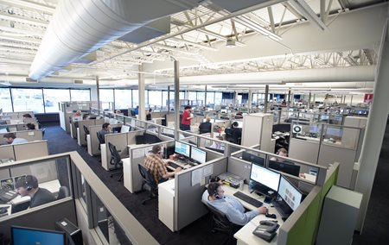
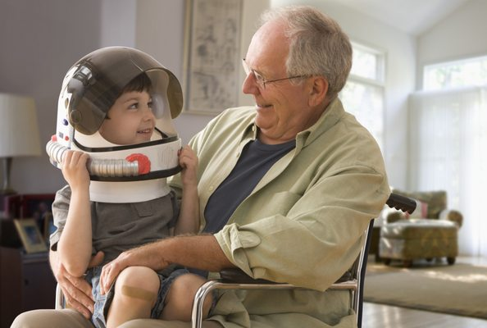
Guest Presentations
Peckham Industries – Lee Chassee
Alternatives in Motion – Colleen Davis

Slide 5
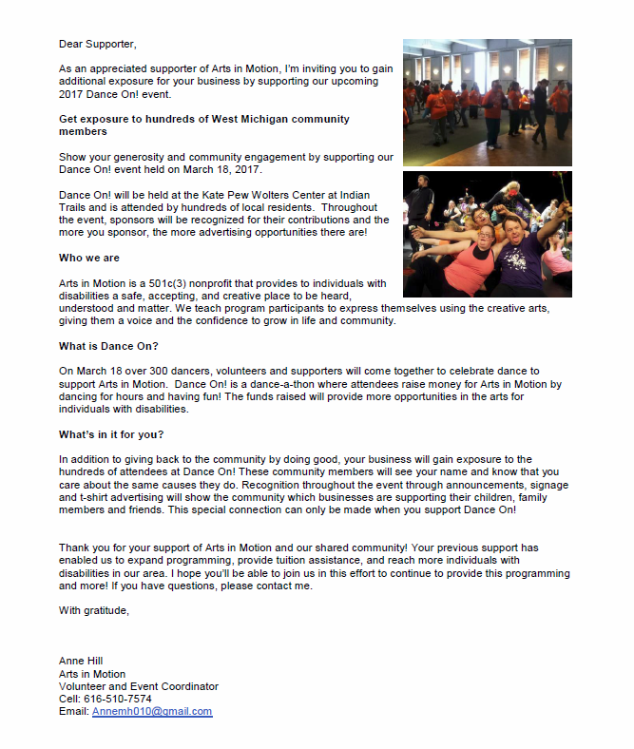

Slide 7
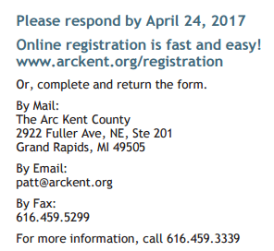

Slide 8
MTSA Conference March 15-17, 2017

Slide 10
Transition Expo Debriefing

Slide 11
Transition Expo Debriefing
What general conclusions might we draw based upon the current information?
Were the Transition Expos successful?
Yes/No?
How do we know?
How might we define and measure future Expo success?
How might we use data to make improvements to the overall Expo experience?
What supports might we consider to help us improve the quality and outcomes of our Expos?
What are our next steps?

Slide 12
Transition Assessment Project
TAGG
Parent Transition Survey
Student Transition Assessment Tool - Revised (STAT-R)
V3 Discovery Process
ESTR-III
Transition Assessment Tool
Motivational Interviewing

Slide 13
CTC Work Group Transition Activity Project
Our Aim – To develop a list of “essential” transition activities.

