Slide 1
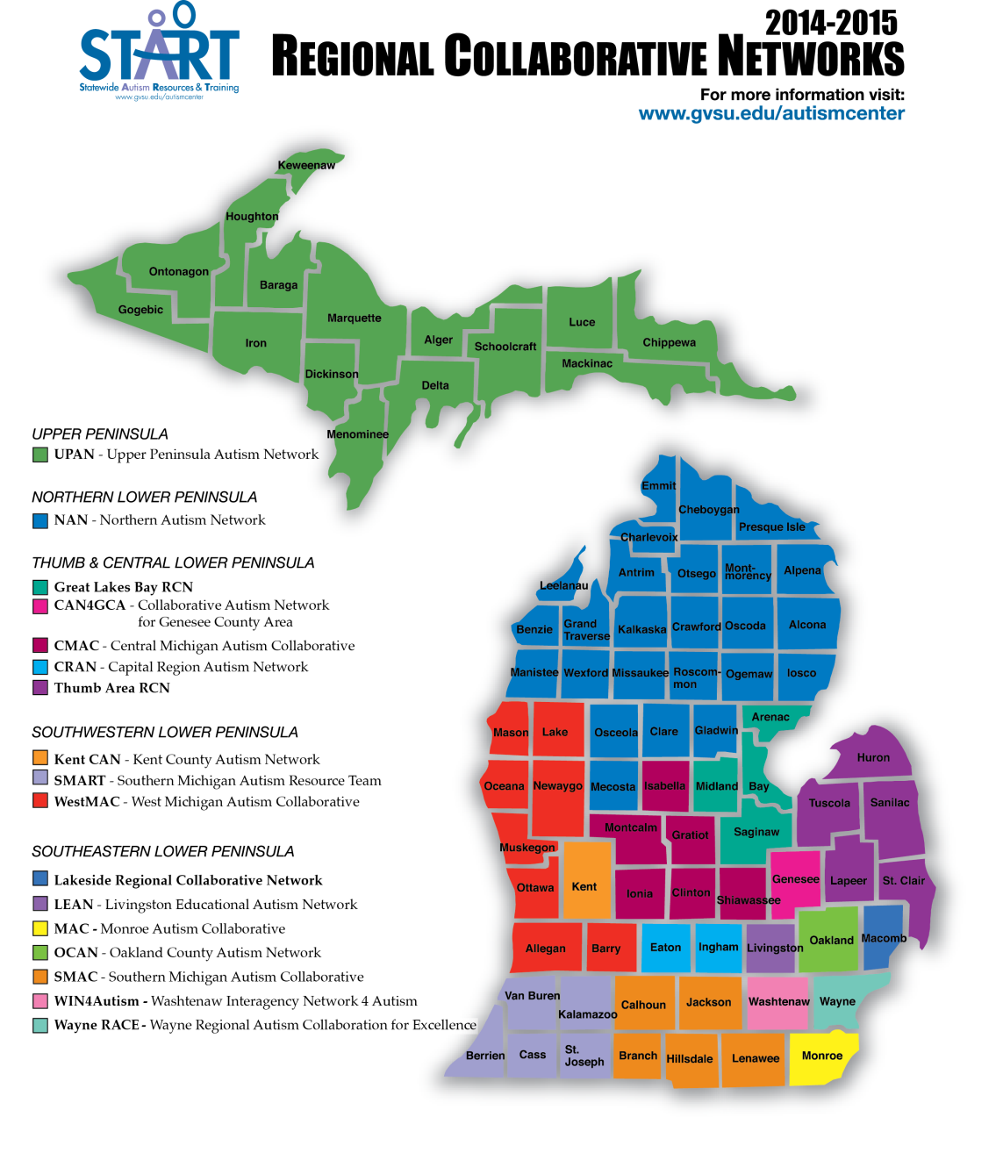
Regional Collaborative Networks Spring Update May 2015
Notes:
Review updated map and indicate it can be found on the website, if needed.

Slide 2
Newest START STAFF
Jana Benjamin—Project Manager
Kellie Bolster—Project Coordinator
Melissa Kurek—Office Manager

Slide 3
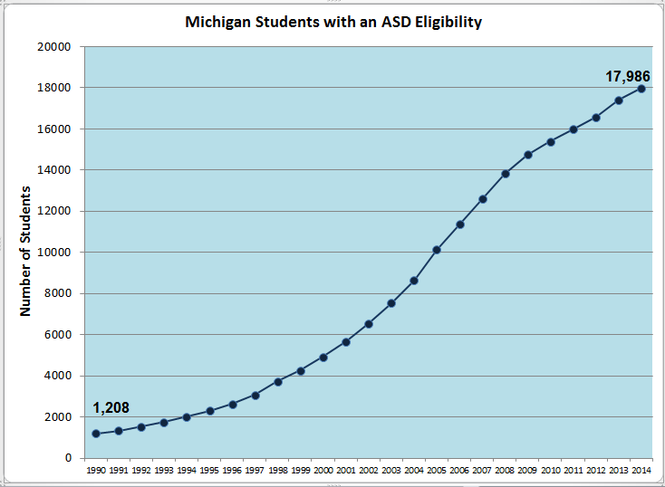
New Numbers
Notes:
Increase of only 29 from 2013

Slide 4
www.gvsu.edu/autismcenter
Notes:
START is staying green so will post as much as possible on the website.
Show participants where to find info on website, including this powerpoint.

Slide 5
National Updates
http://www.nationalautismcenter.org/national-standards-project/phase-2/

Slide 6
State Updates: Office of Special Education (OSE)
Some Focus Areas for Projects:
Demonstrating Academic Growth
Literacy
Family Engagement

Slide 7
START Updates: START Tools for ‘14-15
Universal Supports Assessment and Planning Tool (USAPT 2.0)
Classroom Environment and Teaching Assessment (CETA) Tool
Student Data Collection
Independence
Engagement
Social interaction

Slide 8
2015-16 START IT Sites
Early Childhood
Macomb w/ St. Clair
Eaton/Ingham
K-12
SMAC (Jackson)
Ottawa
Building Your Future (BYF)
Oakland Schools

Slide 9
Due to Popular Demand 2016-17 START IT Sites
So many applications for ‘15-16…
All or Most Early childhood, K-12, and BYF sites may be confirmed for ‘16-17

Slide 10
2015 Fall Leadership: November 2nd
2016 Conference and RCN Leadership Day: To be announced
Watch the START Events page for ‘15-16 training dates

Slide 11
START Updates -- Modules
NEW MODULE: Self-Management
Full day module
Driven by Presenting Problem
Problem-Solving Questions

Slide 12
CET Expansion Components
The New Reality in Evaluations for ASD
More Kids
Additional Players: Autism Insurance Benefit
Increasing Complexity
Expanded MARSE Eligibility Criteria
Contextual Application of CET
Differential Eligibility

Slide 13
Updated Concepts in Ed Strategies: Academic Growth / Literacy Behaviors Associated with Learning (turn paper in)

Slide 14
Peer to Peer Manual Purchase

Slide 15
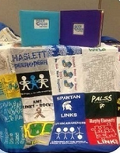
START Peer to Peer Quilt
Send us your new peer to peer t-shirts for the next quilt!
To check out the quilts for your next event, go to the START website under Peer to Peer!!

Slide 16
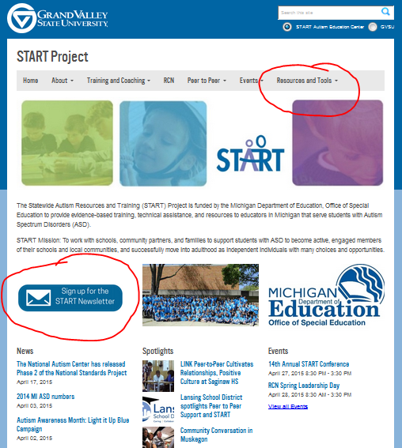
Sign up for the Newsletter

Slide 17
RCN Priorities 2015-16
Professional Development with Impact
Coaching for Implementation of EBP
Secondary Transition
Peer to Peer Support
Family and Community Engagement

Slide 18
RCN Application Priority Changes for 2015-2016
Coaching (addition)
USAPT Data
Reporting of Target student data (independence, engagement, social interaction, academic growth)
Family and Community Engagement (new priority)
Parent mentors from Michigan Alliance for Families involved with RCN
Use Passport w/ families/students

Slide 20
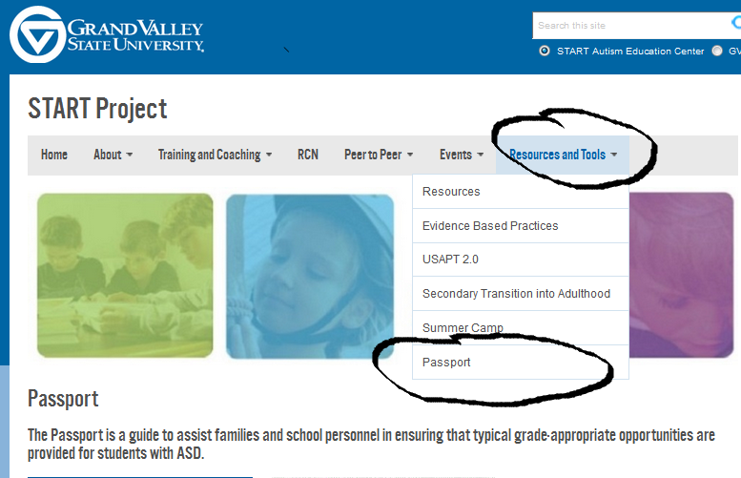
Passport Webpage

Slide 21
The XTREME RCN CHALLENGE
USAPT & Passport

Slide 22
Technical Assistance (TA)
Peer to Peer Support TA Application http://www.gvsu.edu/autismcenter/peer-to-peer-support-2-140.htm
(bottom of the page)
Community Conversations TA Application http://www.gvsu.edu/autismcenter/building-your-future-project-139.htm
(bottom of page)

Slide 23
Using Dropbox
CAUTION:
--Copy and Paste (don’t cut and paste or the item will be removed from its original location)
--Don’t work on docs at the same time—it will only save one version

Slide 24
RCN Communication Plan and 2015-16 Calendar
Notes:
Be sure you have an accurate listserv or email group for communication.

Slide 25
Have an AMAZING Summer

Slide 26
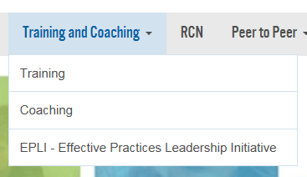
Trainer Process www.gvsu.edu/autismcenter

Slide 27
