Slide 1
Positive Behavioral Interventions and Supports
Introduction to PBIS:

Slide 2
Goal
To create an environment where no student falls through the crack
This is accomplished by creating a school environment where student safety and demonstration of socially appropriate behaviors can lead to an increased emphasis on academic productivity
  Academics vs. behavior is the ultimate chicken and egg question

Slide 3

What does SW-PBIS look like?
>80% of students can tell you what is expected of them & give behavioral example because they have been taught, actively supervised, practiced, & acknowledged
Positive adult-to-student interactions exceed negative interactions
Function based behavior support is foundation for addressing problem behavior
Data- & team-based action planning & implementation are operating
Administrators are active participants
Full continuum of behavior support is available to all students
Notes:
Trainer Notes:
Recall that Vision was one of the five important building blocks in complex change. If we want effective change to occur, we need to know where we are headed. We looked at examples of PBIS Kick-Offs earlier in the day to help give a vision of that end point, but what does full implementation of SWPBIS look like after the Kick-Off? Here are some descriptors…
If trainers have ever been part of doing a SET, you might be able to provide a quick example of random students being able to state the SW expectations. Teams will learn about the positive to negative interactions during the training series. Function based behavior support refers to thinking about why the behavior is occurring (what function or purpose is the student getting from it) and meeting the student’s need in a different, proactive manner. Full Implementation as described on this slide is the end goal of this process.

Slide 4
Why Behavior Supports?
Implementation of schoolwide positive behavior support leads to increased academic engaged time and enhanced academic outcomes
  (Algozzine & Algozzine, 2007; Horner et al., 2009; Lassen, Steele, & Sailor, 2006)

Slide 5
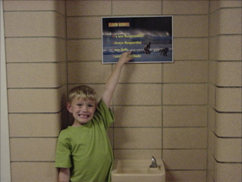
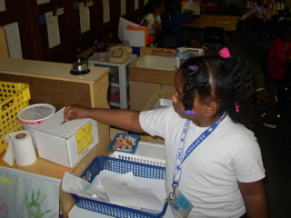
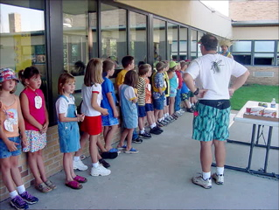
Big Ideas to Improve Behavior
Identify & define behavior expectations
Teach behavior expectations
Monitor expected behavior
Encourage/acknowledge appropriate behavior
Correct inappropriate behavior
Use data for decision making
Notes:
5
So, what does it look like for a school building who chooses to participate with MiBLSi? In the area of behavior, the big ideas are based on the work from the national center for behavior interventions and supports. These ideas connect to building practices. First, school staffs decide on 3-5 positively stated rules, and then objectively define what those rules look like across schools settings. Next, the appropriate behavior is taught explicitly in each setting, and it is monitored by all staff. Appropriate behavior is encouraged through additional teaching when necessary and a system of positive acknowledgement for students. Finally, staffs develop a continuum of responses for correcting inappropriate behavior. They collect ongoing information regarding their level of implementation and impact on student behavior.
We will talk about correcting inappropriate behavior in January during PBS Day 3. That day will also include classroom management.

Slide 6
Identify and Define Expectations
Notes:
6

Slide 7
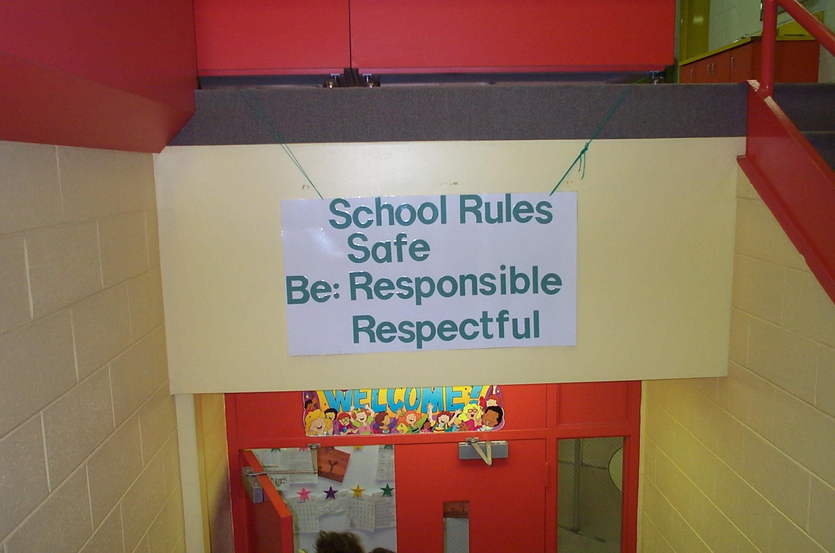

Consider your impressions
of this school
School Rules
NO Food
NO Weapons
NO Backpacks
NO Drugs/Smoking
NO Bullying
Notes:
7

Slide 8
Identify School-Wide Expectations for Social Behavior
3-5 Expectations
Short statements
Positive Statements (what to do, not what to avoid doing)
Memorable
Visible
Notes:
8
These are some guidelines for identifying schoolwide expectations:
We should limit the number so that staff, students, and parents can all easily remember them. The 3-5 should be global enough that they can be expanded upon for different settings and that they capture all relevant behaviors
They should be brief—we can get into the details when we complete the expectations matrix later
Recall the hallway sign 2 slides back. If we only teach students what not to do, then we leave them wondering what appropriate behavior really looks like.
Many schools use acronyms (based on school theme or mascot) to facilitate recall of the expectations. (more examples to come)

Slide 9
Define Expectations
Transform broad school-wide expectations
  specific, observable behaviors
  positively stated
  location-specific
Notes:
9

Slide 10
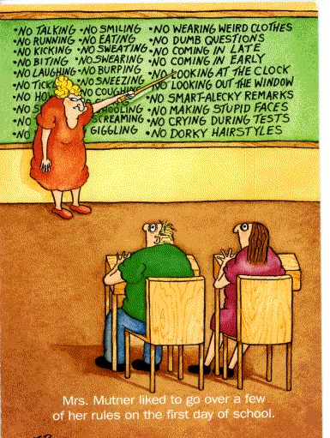
Sometimes, we have too many to remember!
Notes:
10

Slide 11
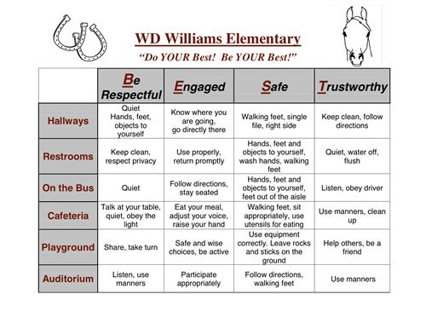
Notes:
Trainer Notes:
Example of a matrix
Please move through the next slides quickly. They are intended to provide examples for the teams to see what a behavior matrix and specific setting visual displays can look like.

Slide 12
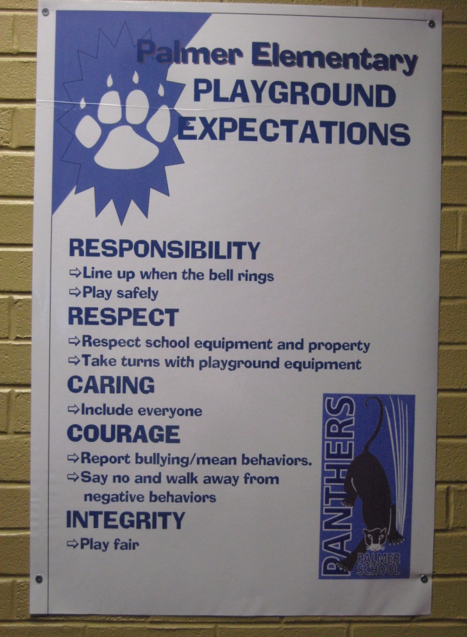
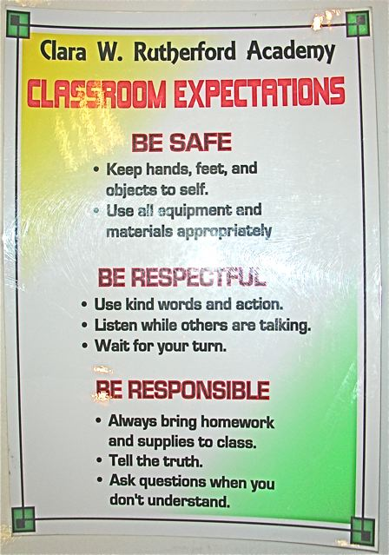
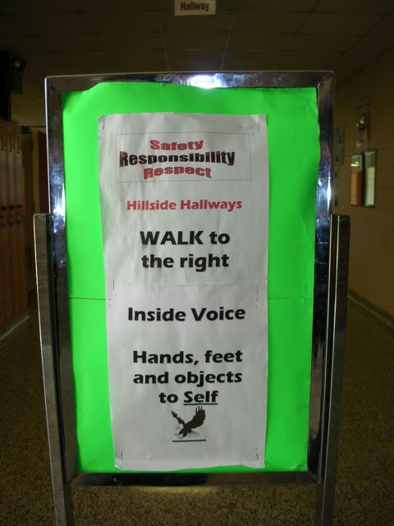
Specific Setting Descriptions of the Behavior Expectations
Palmer Elementary
Rutherford Academy
Hillside Middle School
Notes:
12
Palmer is a GRPS school.

Slide 13
Teach Behavioral Expectations
Notes:
13

Slide 14
“If a child doesn’t know how to read, we teach.”
“If a child doesn’t know how to swim, we teach.”
“If a child doesn’t know how to multiply, we teach.”
“If a child doesn’t know how to drive, we teach.”
“If a child doesn’t know how to behave, we……..... ……….teach? ………punish?”
“Why can’t we finish the last sentence as automatically as we do the others?”
Tom Herner (NASDE President ), 1998
Notes:
14

Slide 15
Teach Behavior Expectations
Define Simply
Model
Practice in Setting
Monitor & Acknowledge Continuously
Adjust for Efficiency
Notes:
Trainer Notes:
Teaching behavioral expectations isn’t a one-shot experience. Teaching the behavior expectations is an ongoing process that begins with defining expected behavior simply, modeling and practicing, monitoring and acknowledging behavior, and making necessary adjustments to the teaching.

Slide 16

Elementary Teaching Example

Slide 17
Monitor Expected Behavior
Notes:
17

Slide 18
Active Supervision
  Movement
  Scanning
  Positive Interaction
    Positive contact
    Reinforcement of expected behavior
Notes:
18

Slide 19
Five Positives to One Negative Ratio
Have more positive student contacts than negative
Use variety of contact forms
Emotional bank account
Notes:
19

Slide 20
Acknowledge/Encourage Expected Behaviors
Notes:
20

Slide 21
Acknowledging SW Expectations: Rationale
To learn, humans require regular & frequent feedback on their actions
Humans experience frequent feedback from others, self, & environment
  Planned/unplanned
  Desirable/undesirable
Without formal feedback to encourage desired behavior, other forms of feedback shape undesired behaviors
Notes:
21

Slide 22
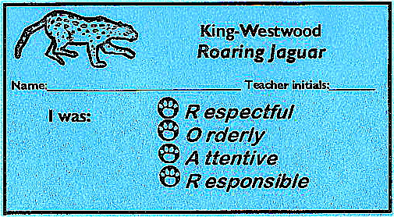
Many schools use a ticket system
Tied into school expectations
Specific feedback on student’s behavior
Provides visible acknowledge of appropriate behavior for student
Helps to remind staff to provide acknowledgements
Jose R.
L.M.

Notes:
22
Acknowledgements given for specific behaviors
Teacher wanted to acknowledge student and gave ticket for student wearing purple so gave ticket (we are not trying to increase wearing of purple)

Slide 23

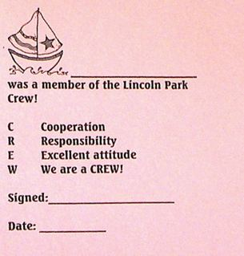
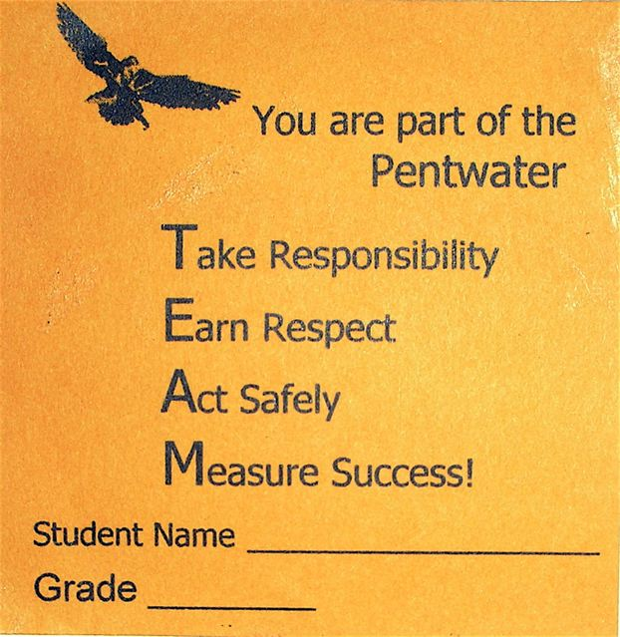
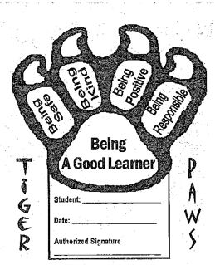

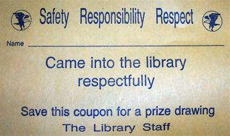


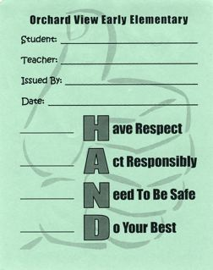
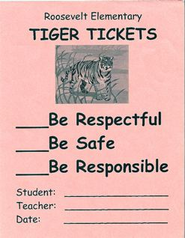
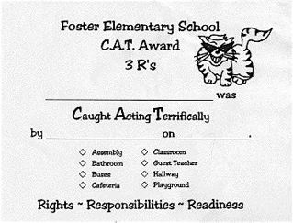
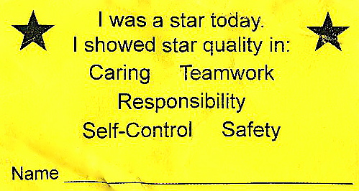
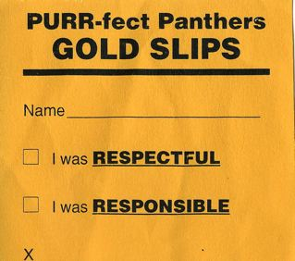
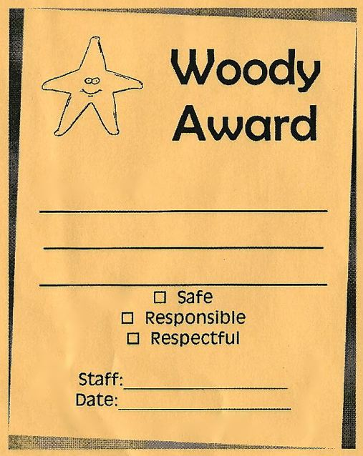
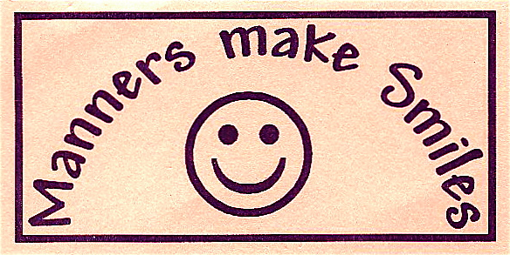
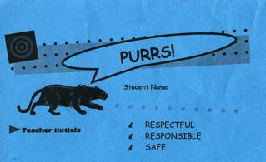
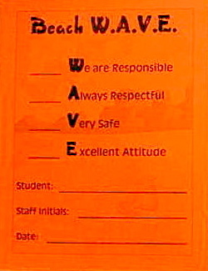
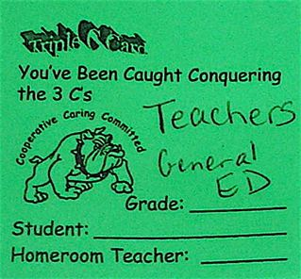
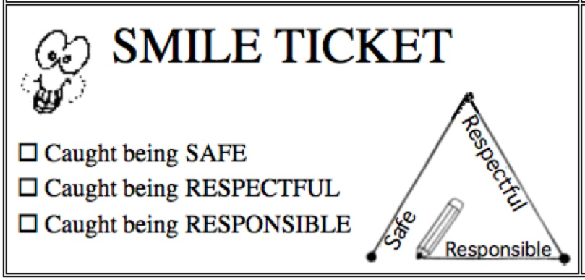


Quick Acknowledgements
Notes:
23

Slide 24
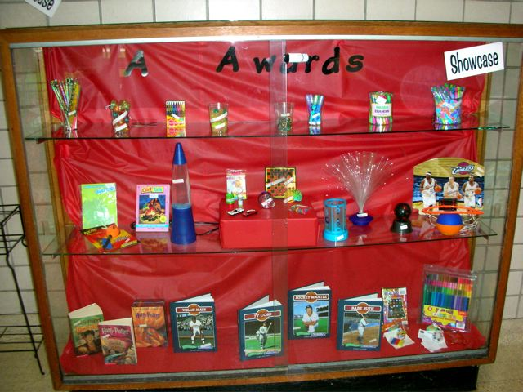
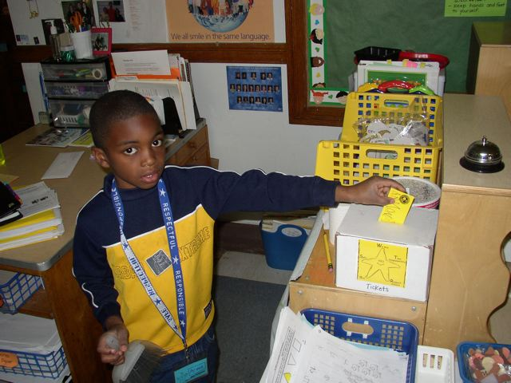
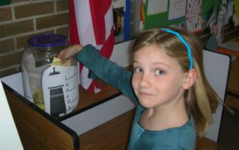
Tickets used in raffle, to participate in celebrations, or to “purchase” items from school store
Notes:
24
Refer to our posters

Slide 25
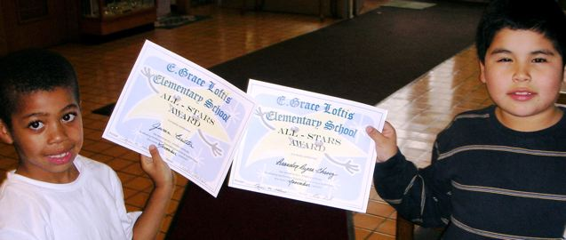
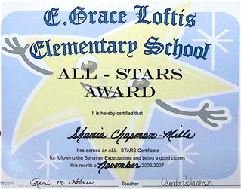
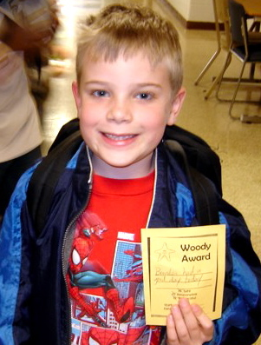
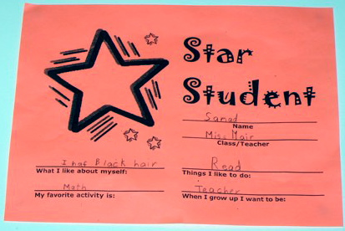


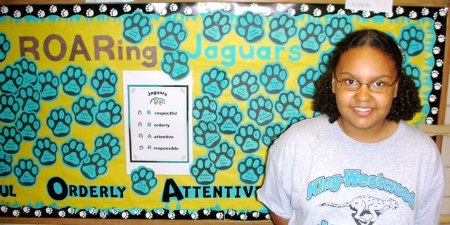
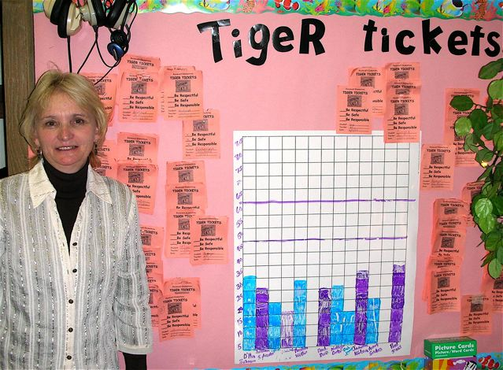
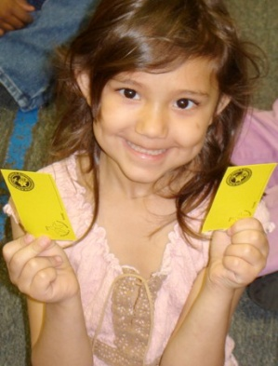
Acknowledge and Recognize
Notes:
25

Slide 26
Correct Behavior Errors
Notes:
26
10:30-12:00

Slide 27

When you treat student misbehavior as an instructional opportunity, you give students the chance to learn from their mistakes.
-Randy Sprick,
Safe and Civil Schools
Notes:
Trainer Notes:
Let’s start talking about what to do in response to misbehavior. The big idea is teaching, reteaching, and pratice.

Slide 28
Negative consequences in PBIS
Do not change behavior - TEACHING changes behavior!
Are a way to “keep the lid on”
Prevent escalation of problem behaviors
Prevent or minimize reward for problem behaviors
Notes:
28
This slide is important to explain before launching into the details about consequences. It helps to put this section into the larger context of what they have already learned.

Slide 29
Correcting Behavioral Errors
Clearly define problem behaviors in observable and measureable terms
Categorize behaviors
Develop a continuum of responses to behavioral errors
Procedures are in place for emergency and dangerous situations
System is written down
Plan for training all staff (including new staff and re-training existing staff)
Notes:
Trainer Notes:
To keep our own emotions at bay and to create consistency in our responses to behavior across staff, locations in the building, and even to prevent student bias, we have to set up a system for responding to behaviors. Here are 6 steps in doing that. We are going to start with the first two steps.

Slide 30
Process for Major vs. Minor Problem Behaviors
Notes:
Trainer Notes:
Here is an example flowchart (this is in the workbook) that illustrates the staff process for defining major vs. minor & staff vs. office managed problem behaviors. Your leadership team should develop a similar process that is simple and clear for staff to implement. It is important to get staff feedback on this process when initially developing your flowchart and on an annual basis to capture any changes within your school climate.

Slide 31
Correct Behavioral Errors Fluently
Notes:
Trainer Notes:
Here is another example of a “menu” of responses to misbehavior. This chart is in the participant workbook. Have participants take a quick look at the chart and shout out any “ah-ha’s” that occur. Note the teaching, re-teaching, and practice that occurs…note the limited use of punitive strategies.

Slide 32
Using Data for Decision-Making
Notes:
32
10:30-12:00

Slide 33
Are we doing what we said we would do?
Student Outcome Data
Data-Based Decision Making for Implementation Success
Program Quality Data
Is what we are doing working?
Notes:
Trainer Notes:
This is an animated slide showing two types of data that are needed for good data-based decision making…This one will highlight program quality data and show that it will help us answer this question, “Are we implementing with fidelity?”

Slide 34
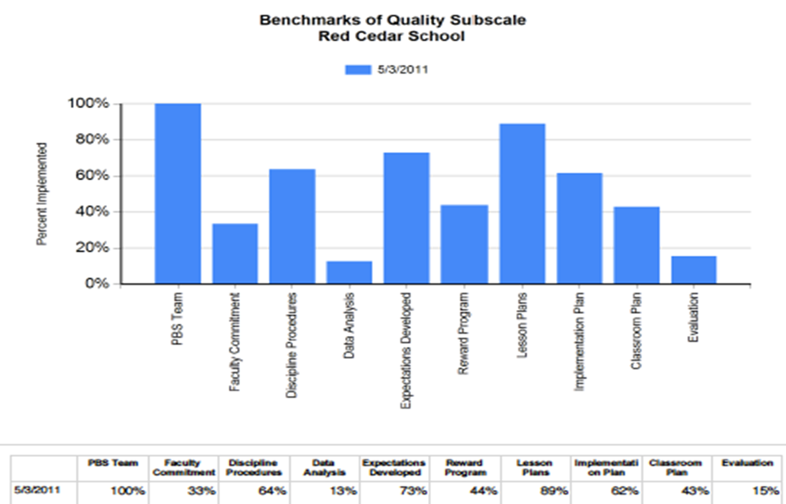
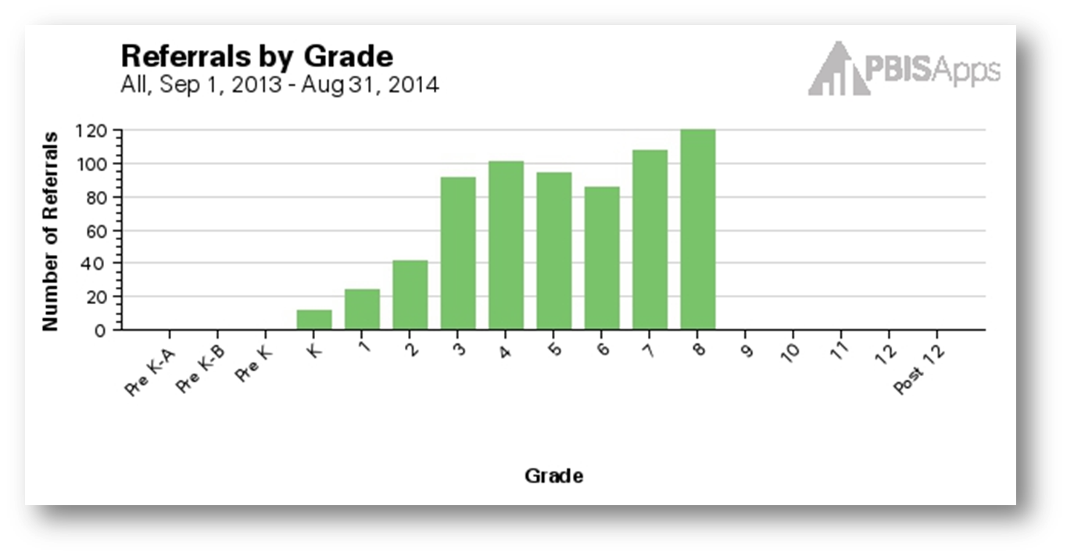
BENCHMARKS OF
QUALITY (BoQ)
SWIS
Notes:
Trainer Notes:
The last component in SWPBIS implementation is certainly not the least. We need to collect data to make good decisions about what we are doing. This slide shows a screenshot of two of the evaluation tools that teams will learn later during this training series…the Benchmarks of Quality which measure how well we are putting the PBIS components in place and SWIS (SchoolWide Information Systems) which measures student outcomes (occurrence of problem behaviors). Trainers might want to ask how many people have used or currently use one or both of these measures.

Slide 35

Make it fun!

Slide 36
Thank you!
More information can be found at
  www.miblsi.cenmi.org
  www.pbis.org
  www.apbs.org
Please feel free to contact me at anytime!
  Kirsten Rice
  kirstenrice@kentisd.org
  365-2293

