Slide 1
SAT 2016
February 6th, 2015
Kent ISD

Slide 2
Background
Michigan law requires both a college entrance and career / college readiness assessment
Michigan’s contract for ACT as the college entrance exam had ended, new RFP was issued
SAT awarded 3 year contract ($17.1 million, $15.4 million less than next bidder)
New WorkKeys contract is $12.2 million
In 2016, juniors will take the SAT and the WorkKeys assessments

Slide 3
2016 SAT
Redesigned test for 2016, paper/pencil
3 Parts
Evidence-Based Reading and Writing
Math
Essay*
MI will require it
Composite Score Scale of 400 – 1600
Test scores of 200 – 800 and 2 – 8 (Essay)
3 hour timeframe, plus 50 minutes for Essay

Slide 4
New Features
No penalty for incorrect or blank answers
Students will edit and revise texts from multiple subjects
Essay prompt released before test, passage will change (is secure)
Essay will focus on explaining how / why author persuaded, argued, used evidence, etc.
Vocabulary will be in context of passage
Scenarios and extended tasks (several questions about same problem / passage)
Founding Documents and Global Conversations items

Slide 5
Evidence-Based Reading and Writing
Reading test
65 minutes, 52 tasks
Score scale 200 - 800
Writing and Language test
35 minutes, 44 tasks
Score scale 200 - 800

Slide 6
Math
80 minutes, 57 tasks
Calculator use on part of Math test
Focus Areas:
Problem Solving and Data Analysis (quantitative reasoning)
The Heart of Algebra (linear equations and functions)
Passport to Advanced Math (complex equations, inequalities)

Slide 7
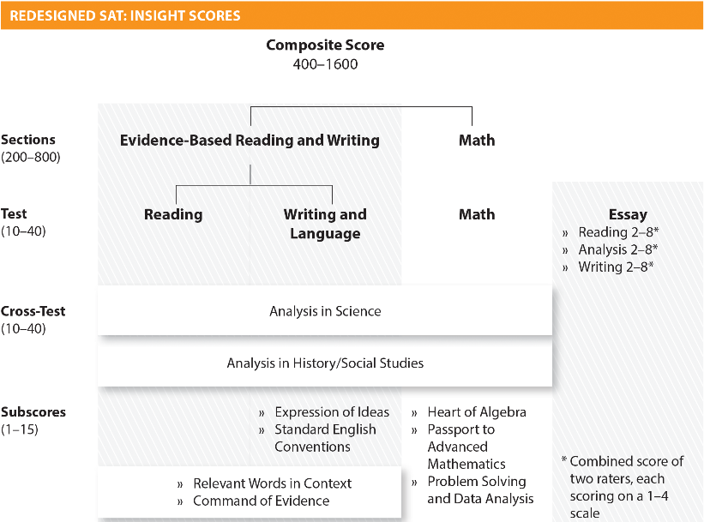
Score Report

Slide 8
Pathway
ReadiStep
8th / 9th grade
Baseline data
Fall testing window
MDE does not have plan for pilot (at this time)
PSAT
9th / 10th grade
Readiness for SAT, success in AP
October testing
MDE does not have plan for pilot (at this time)
SAT
11th / 12th grade
MI will provide it to all juniors
Likely to keep current testing window

Slide 9
ReadiStep
Baseline for PSAT and SAT
Direct relation of scores to PSAT and SAT
Given to 8th or 9th grade students
Reading, Writing, Math
No essay or CR
$8 / scored sheet
Unused test fee if more than 20% of ordered materials are not used
2 hours or 3 class periods
40 minutes per section

Slide 10
PSAT / NMSQT
Preliminary SAT
Predictive of future SAT score
Redesigned PSAT available in October 2015
Usually given to sophomores
Is used for National Merit Scholarship programs
Often used for G & T program entry

Slide 11
Practice Materials
Free - will be available online and through Khan Academy (May)
Paid – The College Board and other commercial vendors
Current materials are for current tests
Reading
https://collegereadiness.collegeboard.org/sample-questions/reading
Writing and Language
https://collegereadiness.collegeboard.org/sample-questions/writing-language
Math
https://collegereadiness.collegeboard.org/sample-questions/math
Essay
https://collegereadiness.collegeboard.org/sample-questions/essay

Slide 12
Helpful Links
Official “Redesigned SAT” site
https://www.collegeboard.org/delivering-opportunity/sat/redesign
Test Specifications for Reading and Writing test and Essay test
https://www.collegeboard.org/pdf/sat/delivering-opportunity/test_specifications_for_the_redesigned_sat_102414.pdf#page=46
Test Specifications for Math test
https://www.collegeboard.org/pdf/sat/delivering-opportunity/test_specifications_for_the_redesigned_sat_102414.pdf#page=137

